Slide 1
What Is Impact?
Research and Enterprise
Anthony Atkin (Research Impact Manager)

Slide 2
What is Impact?
Research Impact is:
“The demonstrable effect that excellent research makes to society and the economy”
RCUK

Slide 3
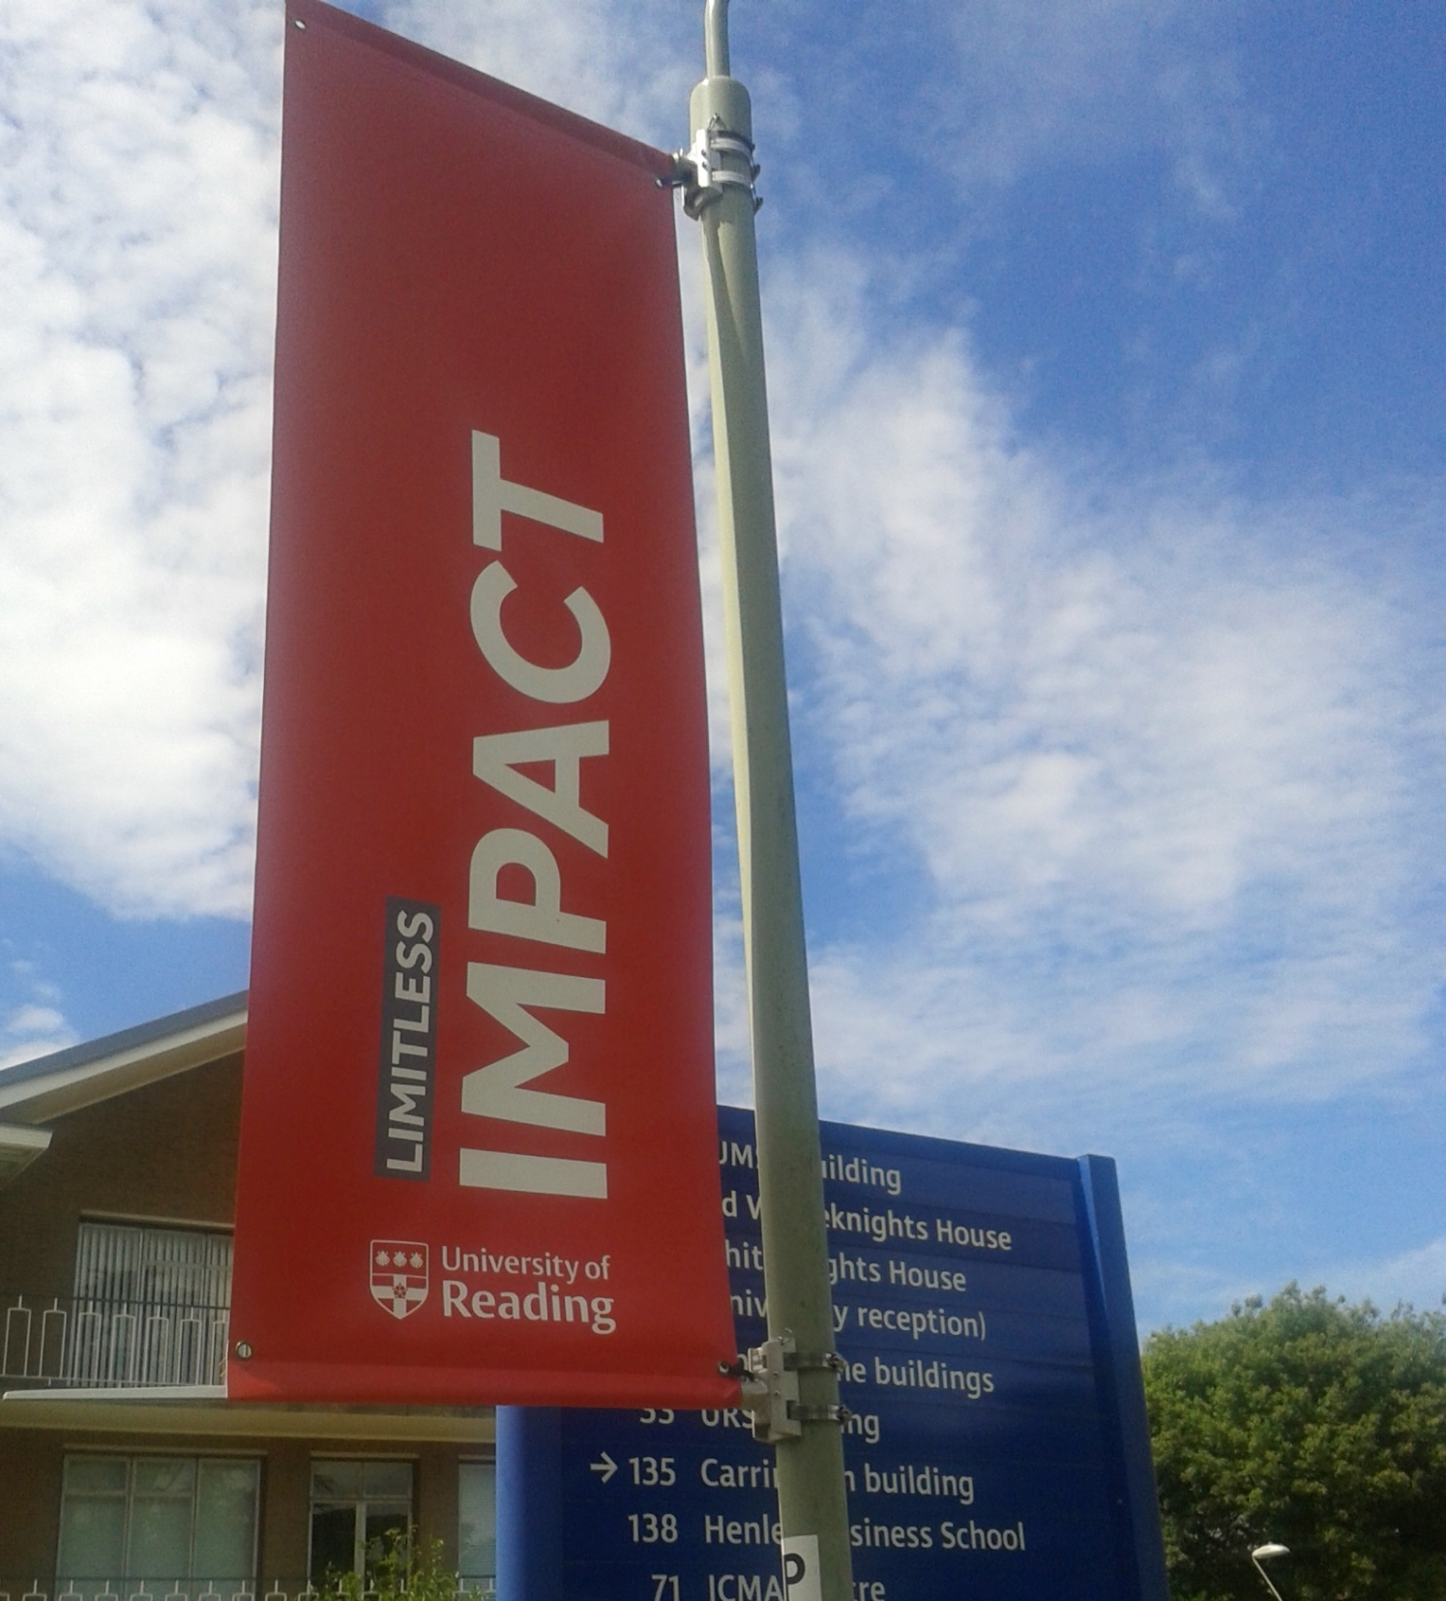
What is Impact?
Research Impact is:
“an effect on, change or benefit to the economy, society, culture, public policy or services, health, the environment of quality of life beyond academia ”
HEFCE

Slide 4
What Is Impact?
Put simply impact is:
The positive effect our research has on the outside world

Slide 5
University of Reading Impact
Reading research resulted in a British and European Standard. This standard has informed the design of public spaces, including the Olympic Park, to make them more accessible to visually impaired people
Geoff Cook, School of Construction Management Engineering

Slide 6
University of Reading IMpact
Reading research has been incorporated into the DVLA Driver Theory Test. This test is taken by 1.3m people per year and has reduced certain types of road accidents by 18%
Frank McKenna, School of Psychology and Clinical Language Sciences

Slide 7
University of Reading IMpact
A digital model of Ancient Rome was created from Reading research. This model has been used in commercial publications and broadcast work, adopted by tourist organisations and supported learning in several universities
Matthew Nicholls, Department of Classics

Slide 8
University of Reading IMpact
Reading research into the role of interpreters in war has been adopted by the Imperial War Museum to exploit the language dimension of its collections, influenced MOD policy and professional interpreter organisations
Hillary Footit, Department of Modern Languages and European Studies

Slide 9
Components of Impact
The concept of Impact can be broken down into five components:
Impact
Need
Research
Share
Adopt
Benefit

Slide 10
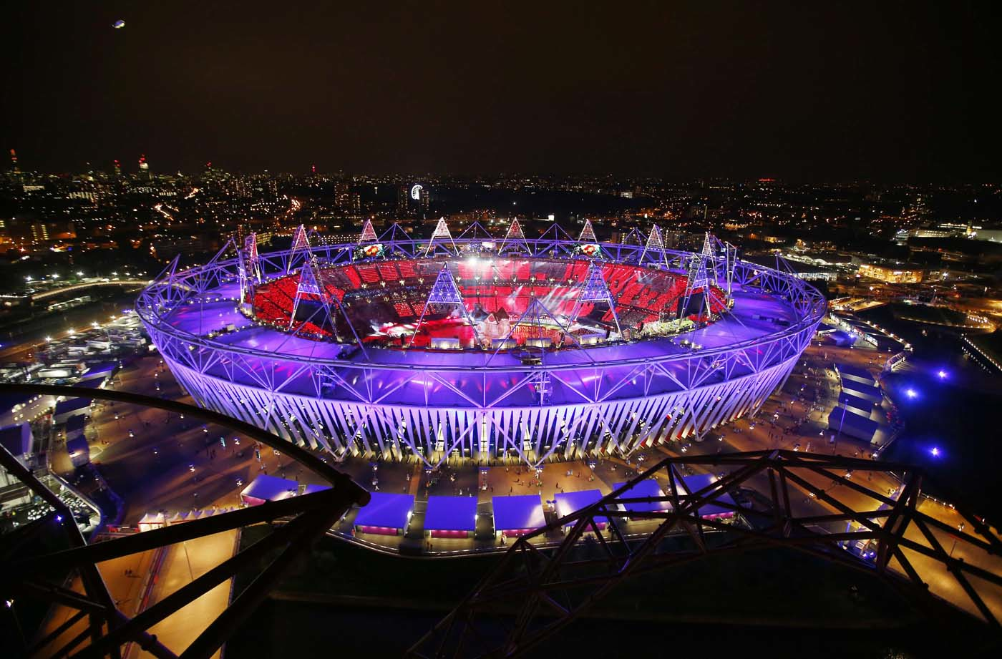
Need
Need
Research
Share
Adopt
Benefit
To achieve Impact, an external Need is often met or responded to
Researchers can increase the likelihood of impact arising from their research by better understanding the Needs of individuals, groups or organisations
The Disability Discrimination Act imposed a Need to improve the built environment for visually impaired people

Slide 11
Research
Need
Research
Share
Adopt
Benefit
Impact has to be based in excellent Research*
Impact is more likely if the needs of external individuals, groups or organisations are considered during the design of the Research
Impact is more likely if the Research is converted into more accessible forms, for example the Digital Rome model
*at least 2* for REF eligibility
The Digital Rome project created a virtual model of Ancient Rome which enables the generation of images and videos of the city for external organisations to use

Slide 12
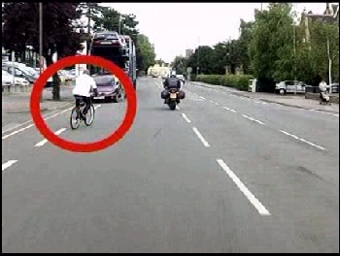
Share
Need
Research
Share
Adopt
Benefit
To achieve impact, the research has to be Shared with external individuals, groups or organisations
Researchers can make Impact is more likely by Sharing their research in a targeted way with stakeholders
The Hazard Perception Awareness Test was shared with the DVLA, Department for Transport, the AA and the Institute for Advanced Motorists

Slide 13
Adopt
Need
Research
Share
Adopt
Benefit
Impact occurs when aspects of research are Adopted by external individuals, groups or organisations
The role of the researcher is to seek feedback or enable the seeking of feedback to evidence this Adoption
The Imperial War Museum adopted messages from Reading’s research to inform the development of their collections

Slide 14
Benefit
Need
Research
Share
Adopt
Benefit
Impact is when the adoption of the research has led to Benefit
This Benefit could be directly to the adopter or to the ‘customers’ or ‘clients’ of the adopter
The role of the researcher is to seek feedback or enable the seeking of feedback to evidence this Benefit
As a result of the adoption of the Hazard Test, certain low-speed collisions have been reduced by 18%, meaning that ordinary motorists have Benefitted

Slide 15
Role of Researchers
The role of researchers in Impact is to make impact more likely through their actions in understanding Need, undertaking their Research and Sharing their research
Need
Research
Share
Adopt
Benefit

Slide 16
Role of Researchers
Adoption and Benefit are outside the control of researchers; they are reliant on the decisions made by external parties
The role of researchers here is to seek evidence of this Adoption and Benefit
Need
Research
Share
Adopt
Benefit

Slide 17
Range of Impact
Impact (Adoption and Benefit) can have wide effects on the following areas:
Health and welfare
Society, culture and creativity
The economy
Public policy and service
Production
Practitioners and services
The environment

Slide 18
Further Information
For further information contact:
Anthony Atkin (Research Impact Manager)
a.atkin@reading.ac.uk
impact@reading.ac.uk
0118 378 7411

