Slide 1
Pathways to impact
Research and Enterprise
Anthony Atkin (Research Impact Manager)

Slide 2
What is it?
The Pathway to Impact is part of Research Council UK* grant applications
It is a two-page document which should outline the steps that will be taken to make impact more likely from the proposed research
Other funders also require statements on impact in their application process
*AHRC, BBSRC, EPSRC, ESRC, MRC, NERC, STFC.

Slide 3
Why is it important?
The Pathway to Impact viewed as important Research Councils UK:
“A clearly thought through and acceptable Pathways to Impact is an essential component of a research proposal and a condition of funding”.
“Grants will not be allowed to start until a clearly thought through and acceptable Pathways to Impact statement is received.”
http://www.rcuk.ac.uk/ke/impacts/

Slide 4
What Should it Include?
The Pathways to Impact should include answers to the following questions:
Who could adopt or benefit from the proposed research?
How could they benefit from the proposed research?
What steps will be taken by you to make this adoption and/or benefit more likely?
The Pathways to Impact should be detailed and specific to the project and include
Detailed milestones and deliverables
Details of costs for the proposed activities

Slide 5
Structuring your Pathways to Impact
http://www.rcuk.ac.uk/ke/impacts/

Slide 6
Suggested Structure
A suggested structure for the Pathway to Impact is as follows:
Context. Restate the proposed research
Who? Who could adopt or benefit from the proposed research?
How? How could they benefit from the proposed research?
What? What steps will be taken to make this adoption and/or benefit more likely?
Timelines
Costs
The following slides describe each section individually

Slide 7
1. Context
Restate the context of the grant and the research proposed
The Pathways to Impact is a separate attachment to the grant and is read separately by reviewers and panel members
Take the opportunity to briefly outline your proposal in order to influence the reviewer
The following items could be included to provide this context:
Grant title (1 line)
Funding scheme information (1 line)
Applicant names (1 line)
Summary of the proposed research and why it is important (max 5 lines)

Slide 8
2. Who?
Who could adopt, be influenced by, or benefit from the proposed research?
These should be non-academic individuals, groups or organisations
There may be multiple groups or organisations within the same field that could adopt/be influenced/benefit
They should be defined in as much detail as possible
Name of organisation
Name of contact
Position of contact

Slide 9
3. How?
How could they benefit from the proposed research?
Explain how the identified individuals, groups or organisations will benefit from the research
These benefits could be to the initial adopters and/or to the customers/clients/stakeholders that the adopters interact with

Slide 10
4. What?
What steps will be taken to make this adoption and/or benefit more likely?
EITHER explain what activities you will undertake to better understand the needs of the groups you have identified by
Developing your network
Seeking opinions from non-academic stakeholders
OR explain what activities you will undertake to use your existing networks to achieve impact from the proposed work
These could include: workshops, trade shows, exhibitions, public engagement events, commercialisation activities, market assessments, supply chain analysis.
Who, How and What should take up ~1 page

Slide 11
5. timelines
The proposed activities to engage with non-academic individuals, groups or organisations should have associated timelines
These could be in the form of
Gantt charts
Tables
Prose
These should include
How these will be managed
Who will be responsible
The timelines should take up ~1/2 a page

Slide 12
6. Costs
The proposed activities should be have appropriate costs associated with them
These could include travel, venue costs, promotional material, website development,
The costs should be:
Realistic and appropriate
Supported by quotes
Link/reference justification for resources section
The costs should be ~1/4 of a page

Slide 13
Examples
The following slides give real examples of pathways to impact from SAPD and SAGES

Slide 14
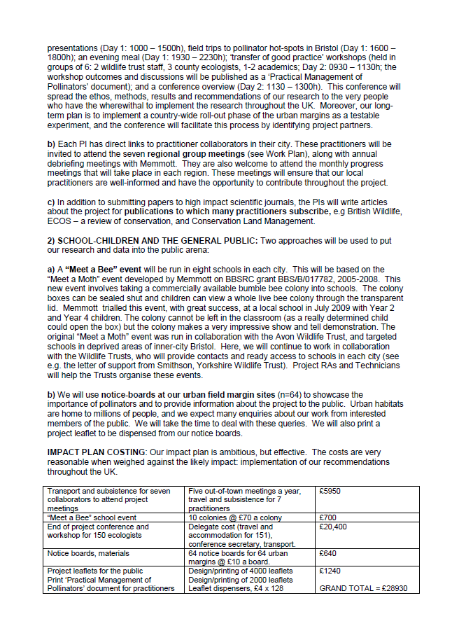

Slide 15
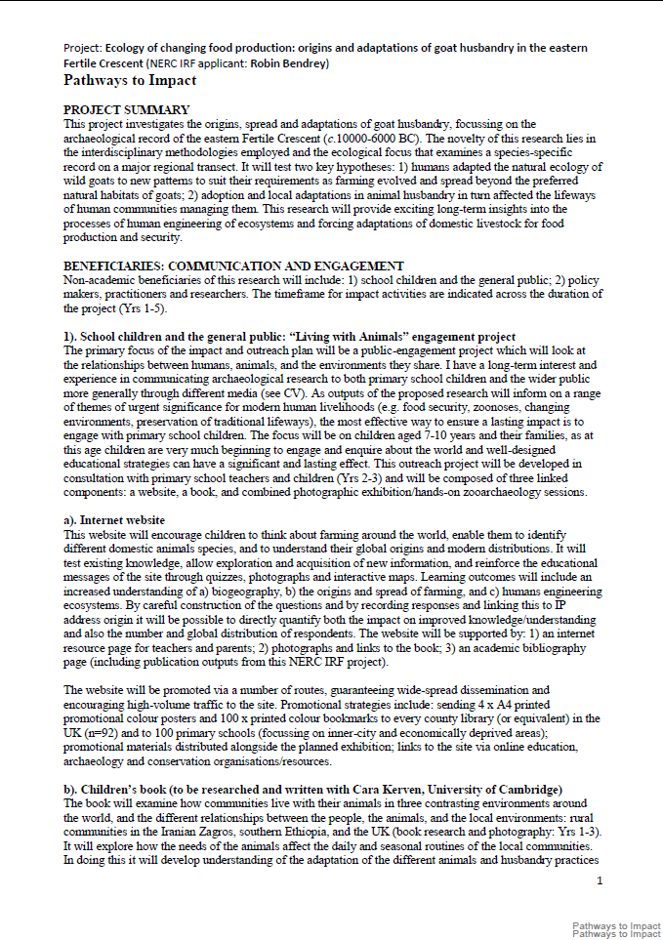
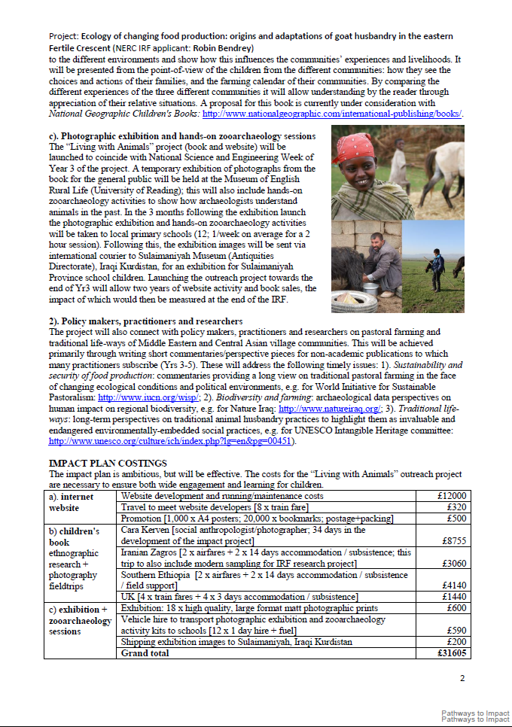

Slide 16
Assessment
The Pathways to Impact are graded
Excellent
Satisfactory
Unsatisfactory
An grant will only be awarded when a Satisfactory pathway to impact has been received
Criteria for BBSRC scoring are included here
http://www.bbsrc.ac.uk/funding/apply/impact/pathways-to-impact.aspx

Slide 17
Do not include…
Generic statements such as “The Press Office will ensure the communication of our research to the public” , these are not specific enough
References to grants you will apply for in the future e.g. follow on funding/further RCUK funding/industrial funding, the referee wants to know what you are going to do in this grant to make impact more likely
Extensive track records in impact (“don’t you know who I am?”): generic statements about how you have been successful in the past do not significantly strengthen pathways to impact unless it is clear that this experience will be used directly in the proposed case
References to academic beneficiaries, publications in high-quality journals, academic conferences; these belong in the Academic Beneficiaries Section

Slide 18
Impact Summary
Within the JeS form there is an Impact Summary section
This section is the public-facing impact section
Here you should identify the broad areas of impact and the potential beneficiaries for a lay-audience (the Who and the How)
This section should not include what you will do to make impact more likely

Slide 19
Contacts
For further advice contact
Anthony Atkin (Research Impact Manager)
impact@reading.ac.uk,
a.atkin@reading.ac.uk,
extn 7411
Research and Enterprise Development Managers
http://www.reading.ac.uk/internal/res/contact/res-contact.aspx

