Slide 1
Pitch presentations
Morning session

Slide 2
IAN Harrison university of reading

Slide 3
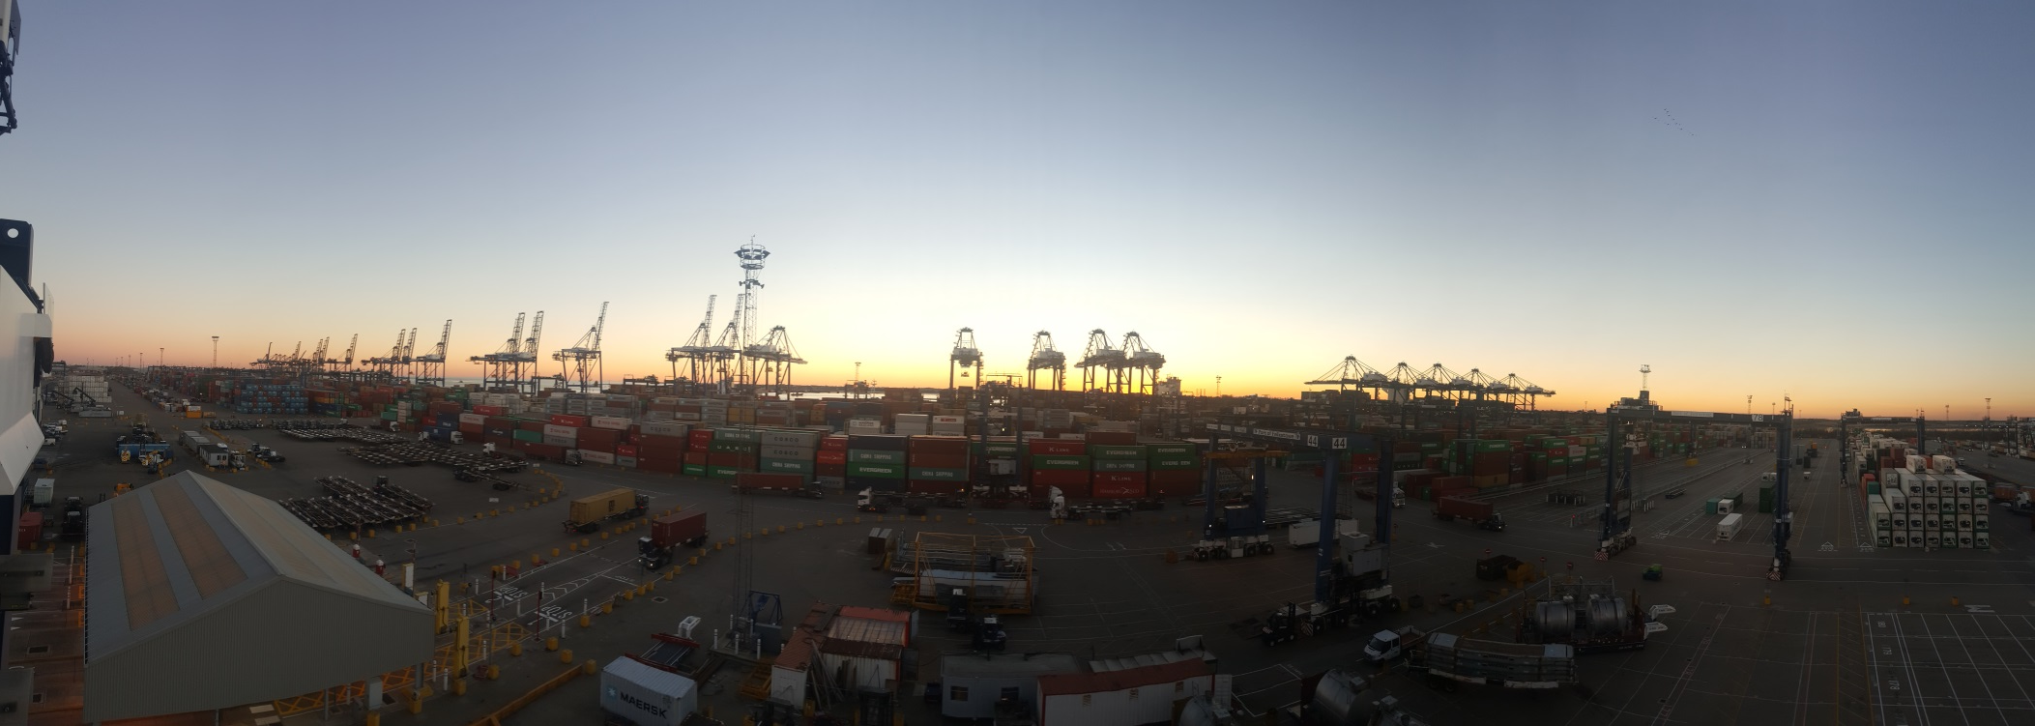

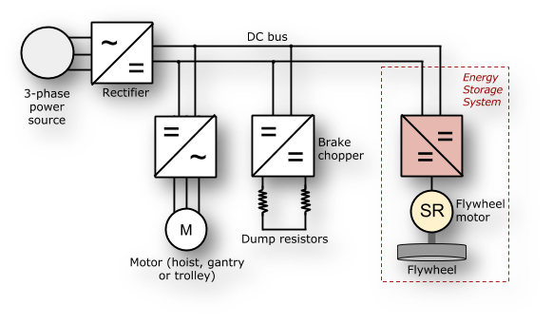
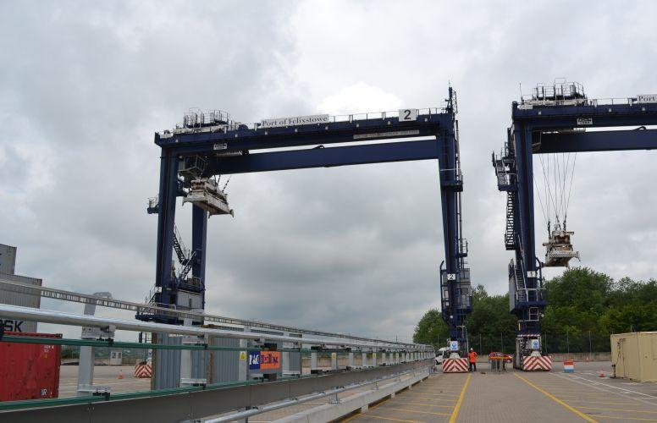
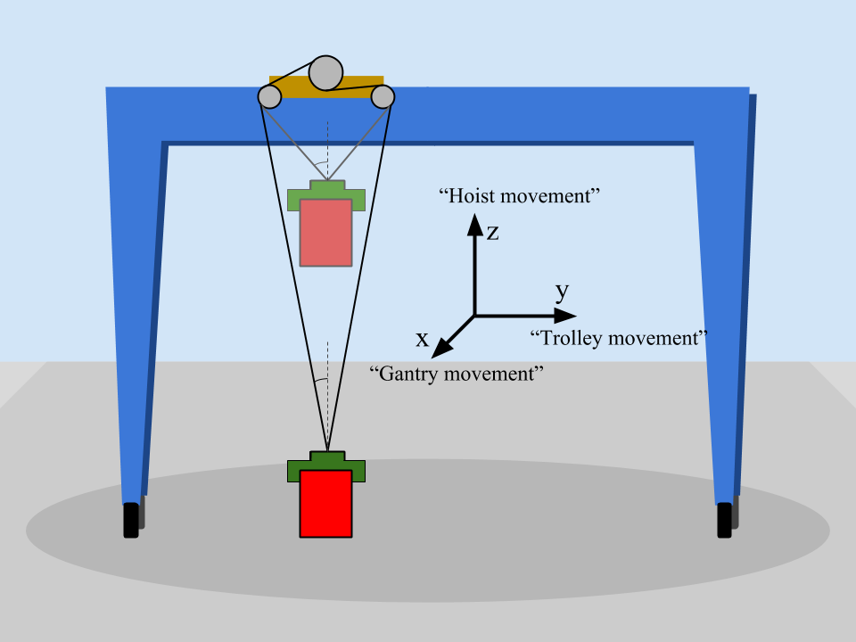

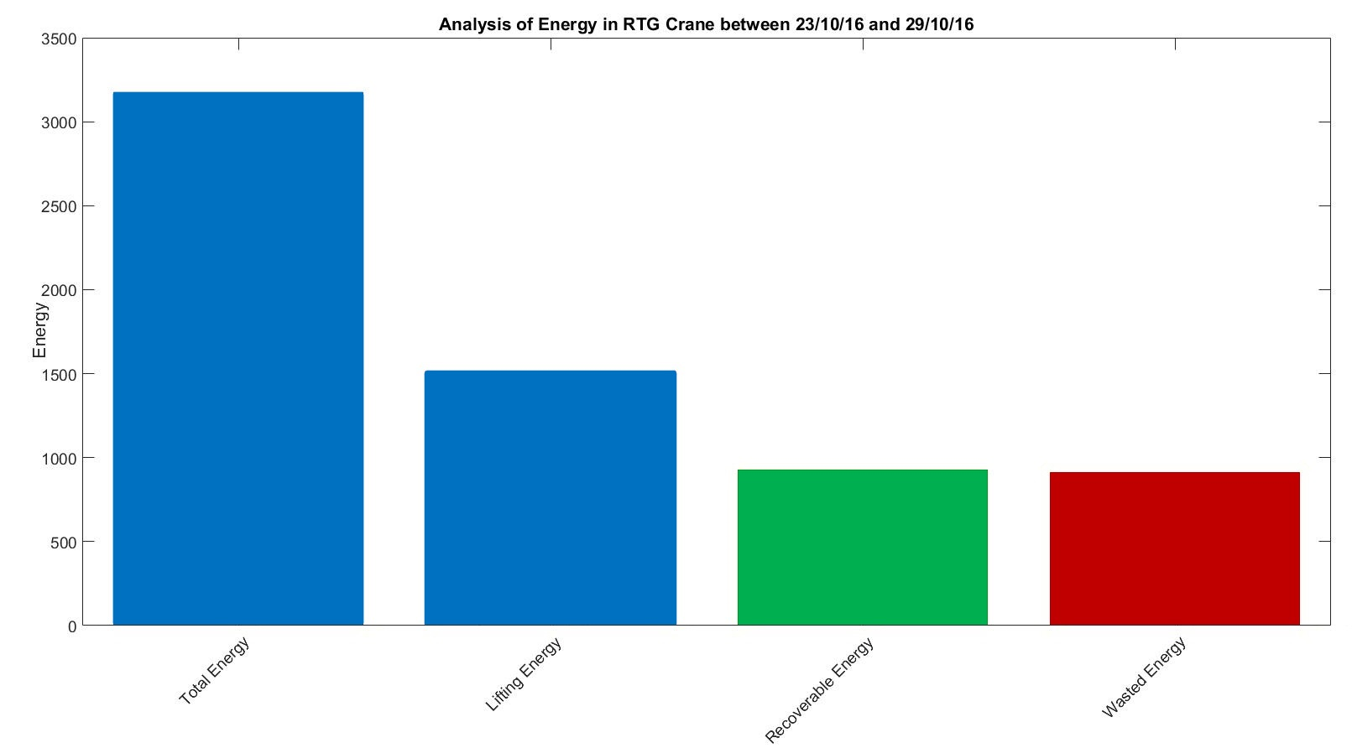
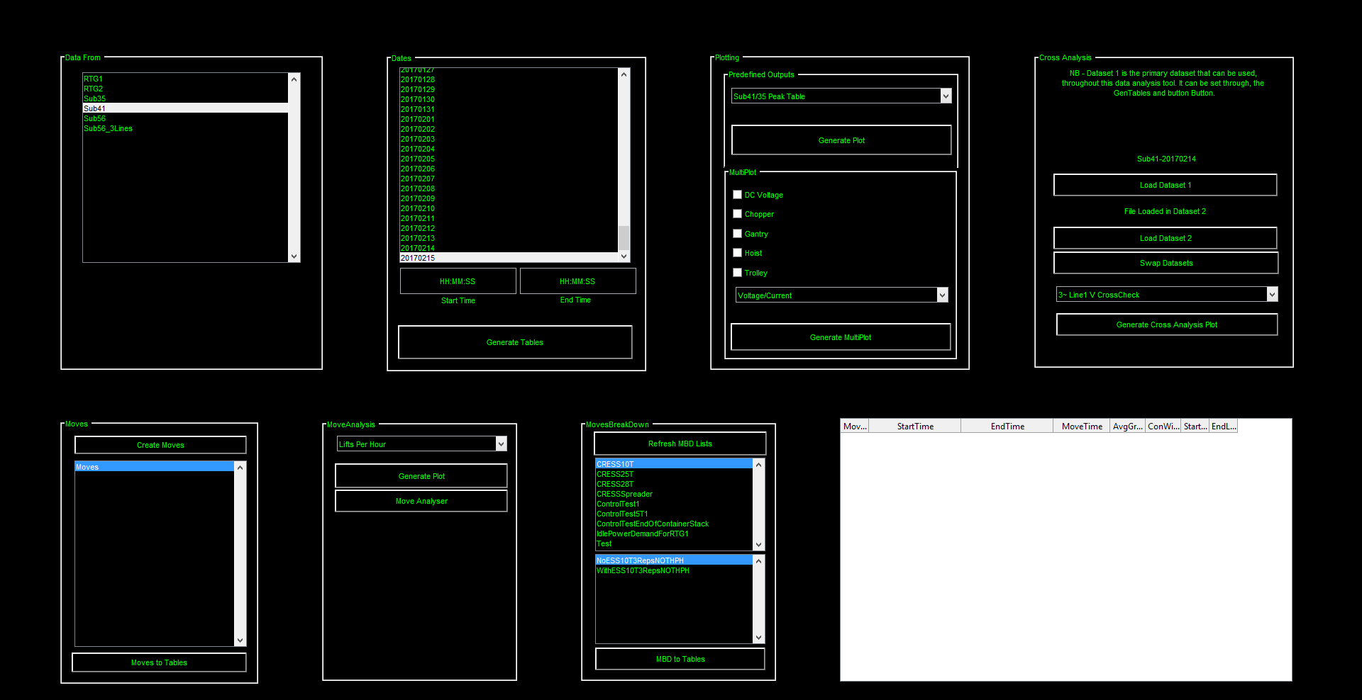
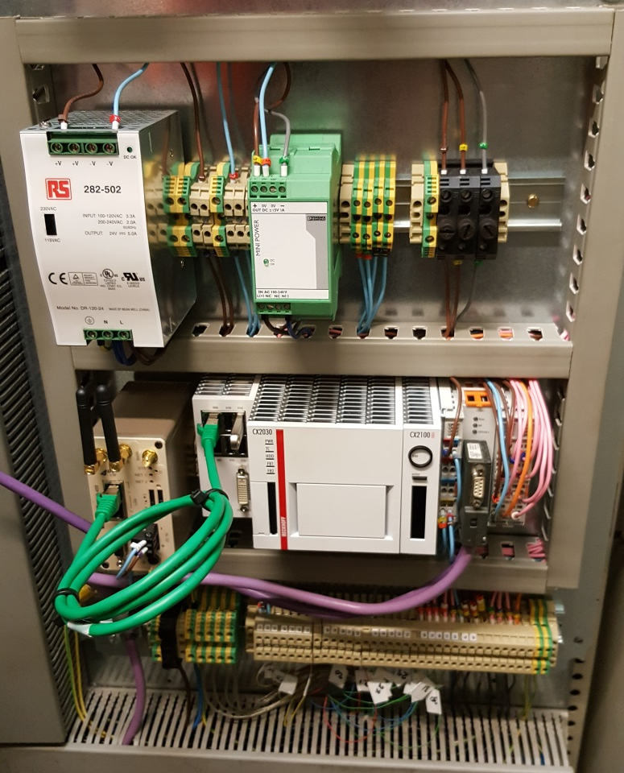



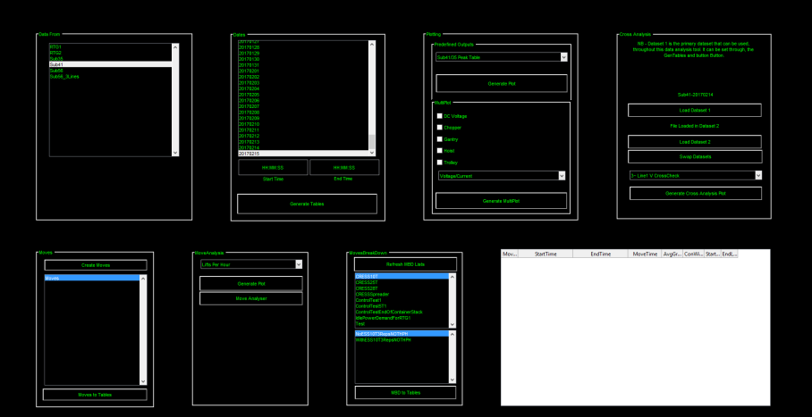

What Do I do?
Work closely with PoF and CRESS
Develop bespoke measurement systems and data analysis tools
All with the overall goal to reduce energy consumption and ultimately carbon emissions at shipping ports

Slide 4




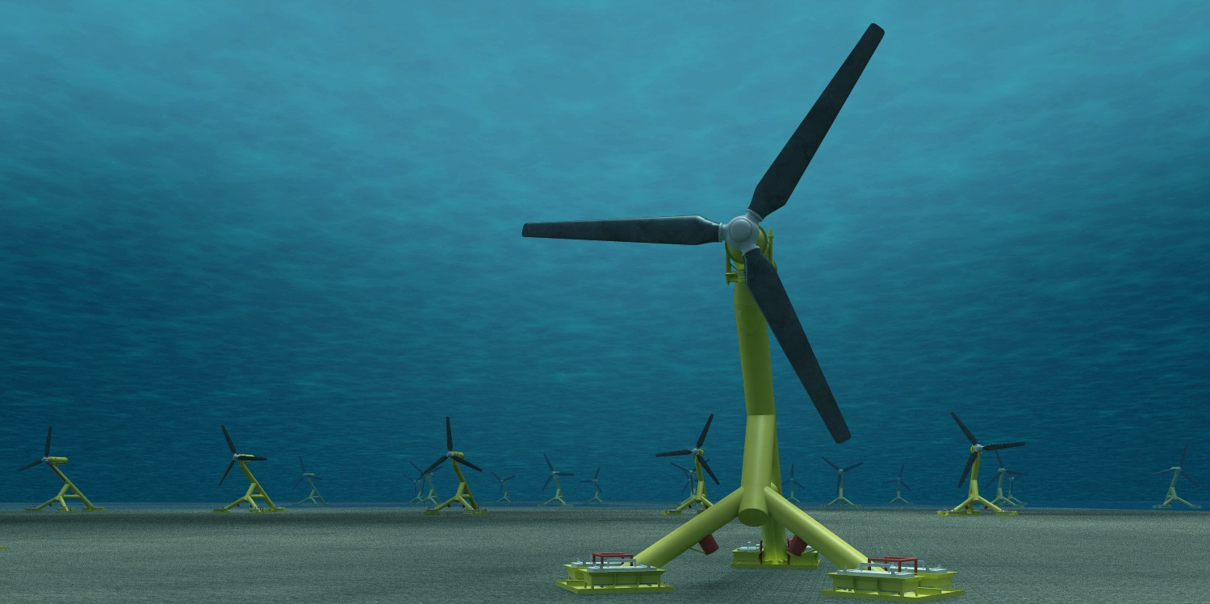



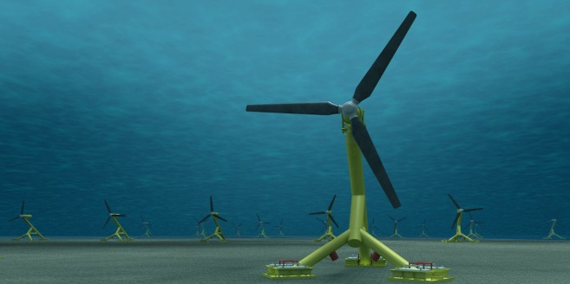

Where Our Project
Can be Applied?
Directly to other Shipping Ports
Adaptation for the national grid and local networks where demand is highly varied
To “smooth out” the power generated by renewal sources

Slide 5




What Could We Add To
Another Project?
Programming Expertise
  PLC Programming
  Data Analysis
Engineering Expertise
  Mechanical
  Electrical
  Power Systems
  Energy Storage

Slide 6
Dai Clegg
Evidence for development

Slide 7
Who are we?
Who do we work with?
What problem do we solve?

Slide 8

Who are we?
Who do we work with?
What problem do we solve?
Household Economy Approach
Individual Household Method
A research-oriented NGO
Part of the Walker Institute
All about livelihoods data

Slide 9
Who are we?
Who do we work with?
What problem do we solve?
We measure & model livelihoods
Swiftly & reliably
Sustainably
  through capacity building

Slide 10



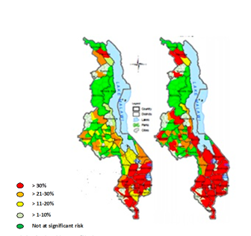

Who are we?
Who do we work with?
Governments
Agencies
Researchers
Early warning systems
  Plan response to shocks
Target Aid
Measure impact
Measure expected impact:
  of projected climate,
  health or other change

Slide 11
Evidence for Development
Measuring Impact; modeling change
Notes:
Independent NGO; part of the Walker Institute.
Our thing is data; data about livelihoods.
Who cares about livelihoods data?
Agencies use livelihoods data to target aid and measure impact.
Governments use livelihoods data to model impact of potential shocks as part of early warning systems.
Researchers use livelihoods data to measure the impact of climate, hydrology, health, yield and other projections on real populations,
We research and develop methods that can quickly and reliably measure livelihoods in rural and urban populations.
We work with governments and universities to build capacity to make this data gathering cheaper and self-sustaining.
We’re part of the HyCRISTAL project; we’ve worked with Farm Africa; we’ve worked with SADC, USAid, DfID and other international agencies.

Slide 12
IoAnnis Zoulias
University of reading

Slide 13

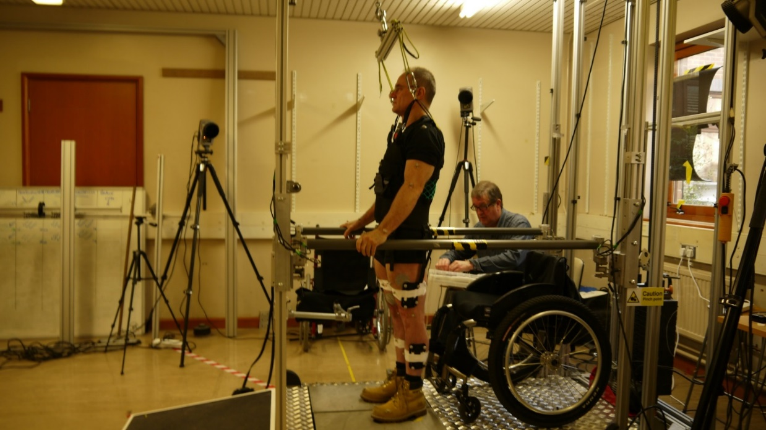
FES Research Group – School of Biological Sciences
http://fesreading.uk
w.holderbaum@reading.ac.uk
Improving bone health in people with paraplegia
FES
Allows
Exercising
Improves
Bone mass density

Slide 14
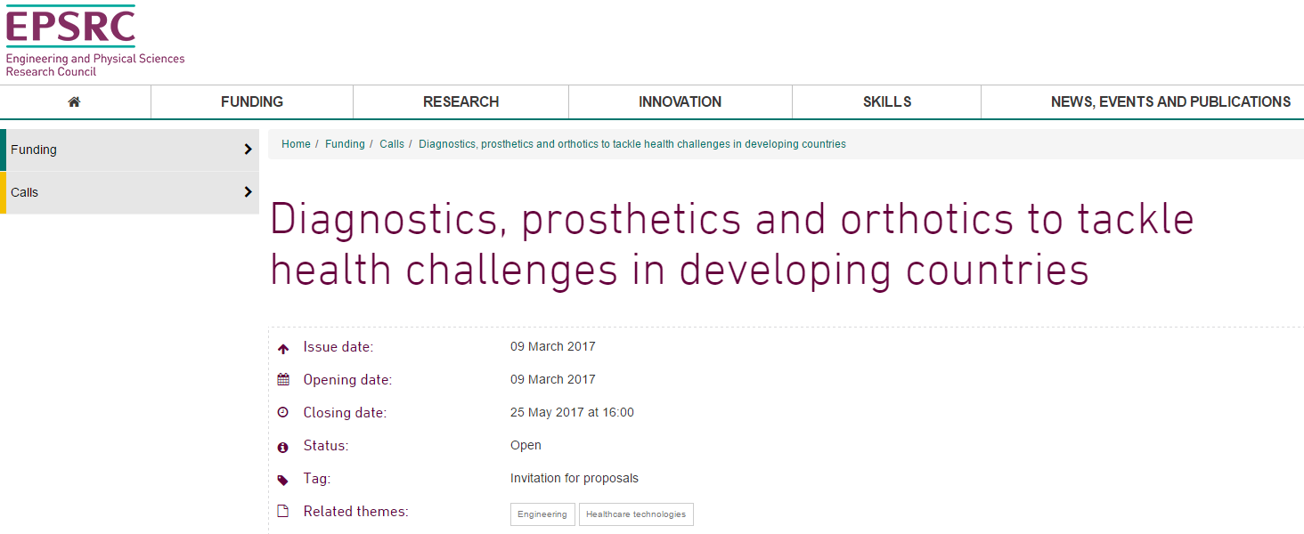
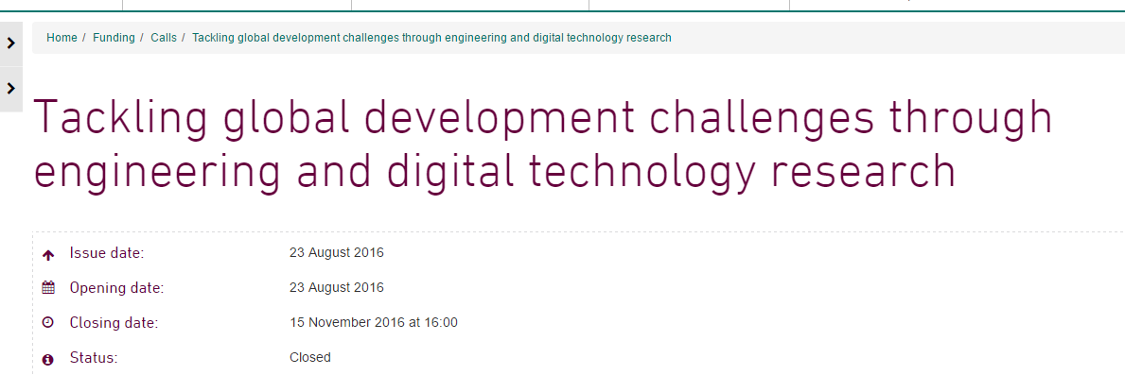
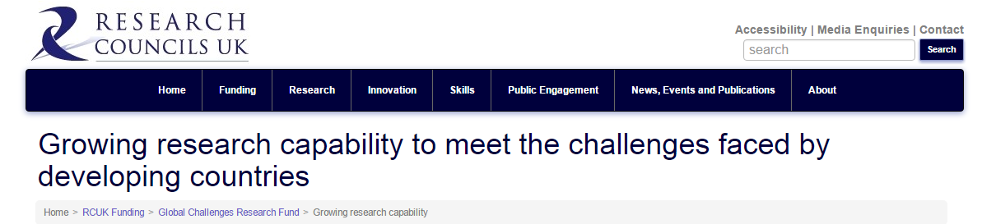
Health and technology in developing countries
FES Research Group – School of Biological Sciences
http://fesreading.uk
w.holderbaum@reading.ac.uk

Slide 15
Impact to other projects
FES Research Group – School of Biological Sciences
http://fesreading.uk
w.holderbaum@reading.ac.uk
Technology
Sensors and smart meters
Low cost electronics
Science
Systems control
Modelling
Health, Monitoring, and Rehabilitation

Slide 16
Aurelija Povilaike
University of KENT

Slide 17
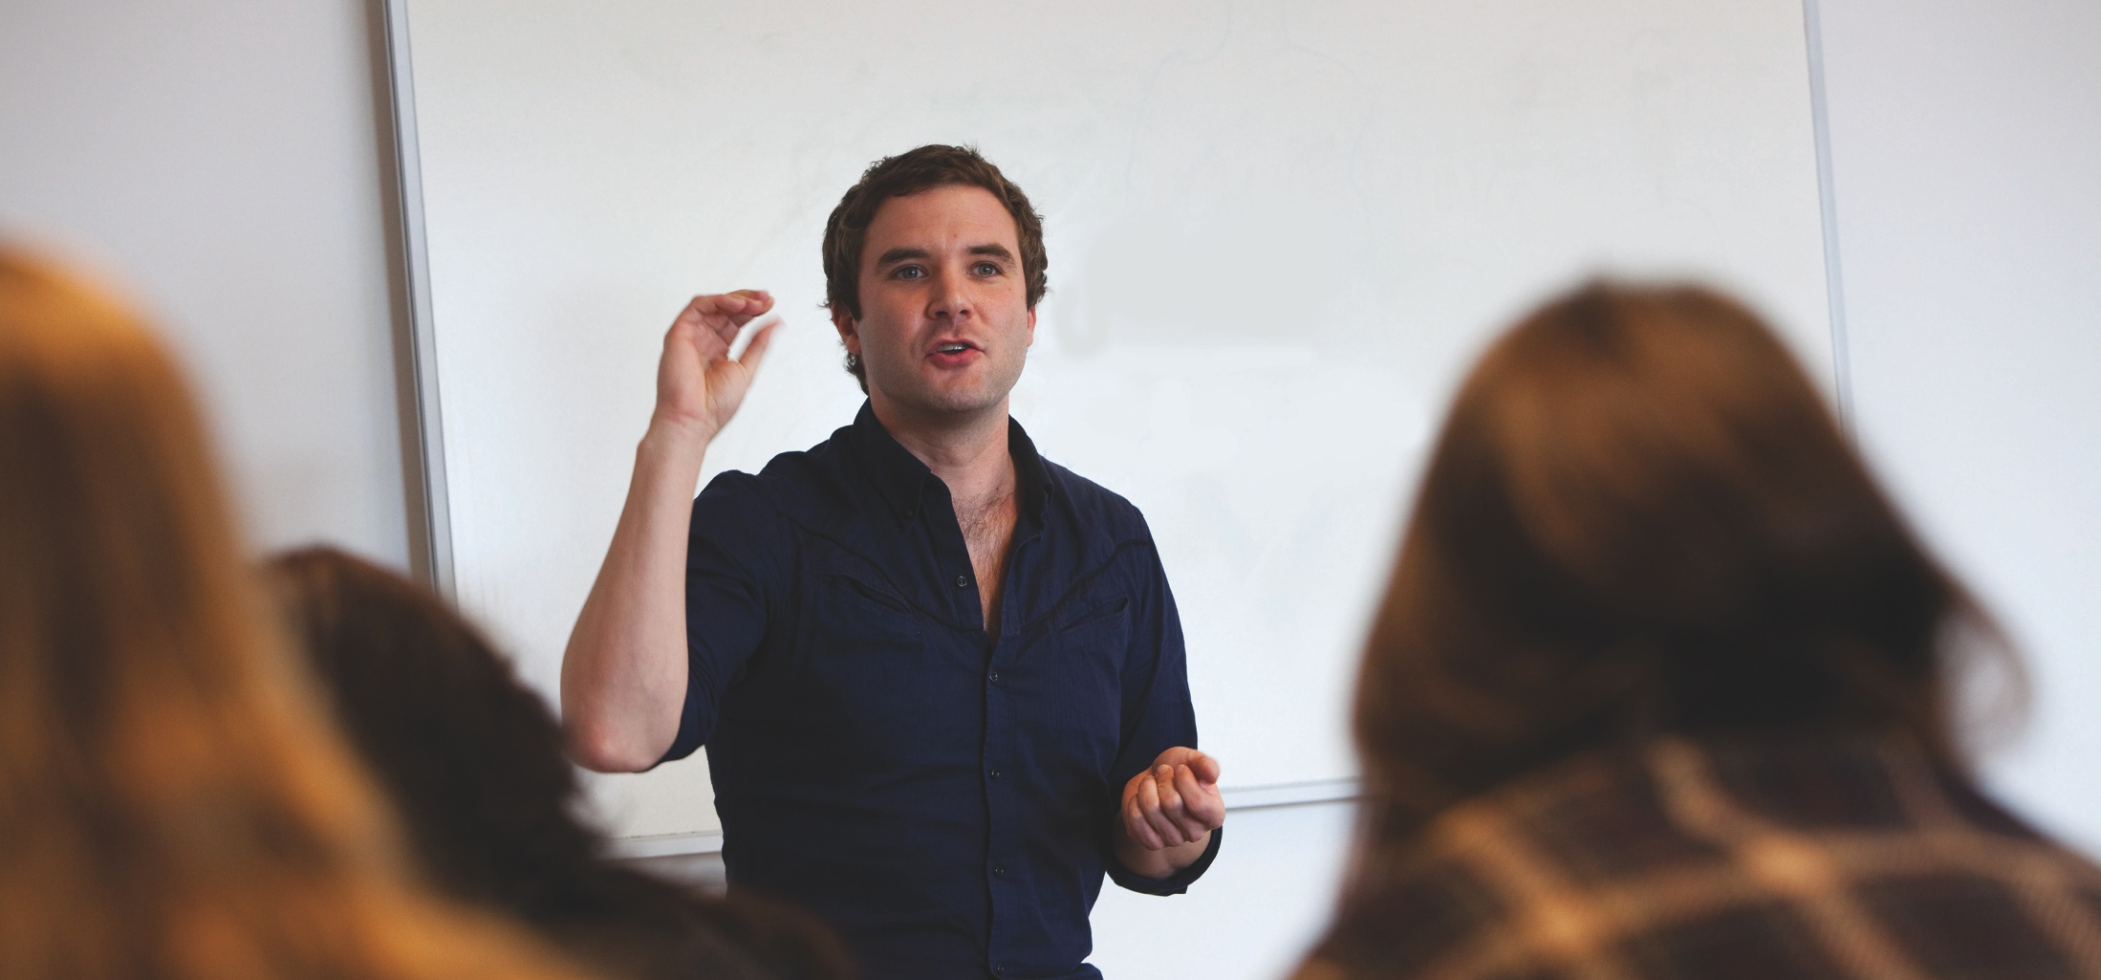
GCRF / University of Kent’s Overview
Aurelija Povilaike, Research Funding Officer, Research Services
Notes:
V1.0
To change the footer on every slide:
1. On the menu go to Insert > Header and Footer…
2. Select the Footer checkbox and enter the footer text in the accompanying text box
3. Click “Apply to All”

Slide 18
What we do ?
Social Sciences
  Health
  Politics and International Relations
  Social Policy & Sociology
  Anthropology and Conservation
  Economics (Agri-Enviroment, Macro, Micro)
Sciences
  Biotechnology
  Pharmacy
  Physical Sciences
Humanities
  History
  English, European Culture and Languages
  Arts

Slide 19
Existing links
Uganda
Mozambique
Indonesia
Columbia
Peru
Seychelles
India
Bangladesh
Thailand
China
East Timor
Kenya
Malaysia
Cambodia
Social Sciences
Sciences
Humanities
Tanzania
Madagascar
Vietnam
Sri Lanka
Turkey
Papua New Guinea
Jamaica
Ukraine
Mauritius
Guinea
Malawi
India
Vietnam
Brazil
Zimbabwe
Malaysia
Zambia
South Africa
Thailand
Mexico

Slide 20
What is next ?
Interdisciplinary Collaborations
New Partnerships, i.e. government, academic, NGOs
How can we support this?
Internal funding for new collaborations (meetings, sandpits, workshops)
Central support in writing, costing and submitting a grant proposals

Slide 21
Maria shahgedanova
University of reading

Slide 22
Building resilience and adaptation to climate change in Central Asia
Maria Shahgedanova, Geography and Environmental Science (m.shahgedanova@reading.ac.uk)
GCRF countries: Kazakhstan (main partner), Kyrgyzstan
Current / past projects
Types of projects we consider
2015-17: ‘Climate change, water resources and food security in Kazakhstan’ (Newton Fund)
EU-funded projects on climate and glacier change in Central Asia
Assessment of desert dust emissions using remote sensing
Assessments of impacts of climate change and variability on
  Glacier change and associated hazards
  Water resources
  Agriculture
Development of preparedness, resilience and adaptation
Ecosystem and climate services

Slide 23
Current research building foundation for future projects
Recent past and projected climate change
Hazards
Water resources
Agriculture
Documenting and modelling glacier change
Soil moisture
Preparedness (work with stakeholders)
In situ, SMOS
+
In situ
Remote sensing
Models
Water availability
Crop modelling
Past changes in runoff; future hydrological scenarios
Evolution of lakes and GLOF
Preparedness, resilience, adaptation

Slide 24
Collaboration
We have
Very extensive links in the region with research institutions and stakeholders
Monitoring facilities established by our previous projects
Extensive data bases
  Multi-model climate projections at 25 km resolution
  Hydrological data bases (daily time step) dating to the 1950s; future scenarios
  Extensive glaciological data bases
  Soil moisture data bases (in situ) and SMOS (near real-time output)
Expertise in climate, hydrological and glaciological modelling, and social science
We need
Shift towards developing near real-time data delivered to stakeholders and seasonal forecasts: Relevant expertise
Collaborators working in Arts and Humanities

Slide 25
SUZ Naeve
CABi

Slide 26
CAB International (CABI)
Suz Neave, Project Development Officer
Notes:
Main title slide to be used at start of presentation- Arial36bold white
may vary depending on heading between min=32pt, max=40pt
Subtitle - Arial28bold white
Credits – Arial14light green, can include:
Data collected by [Add names of contributors and production team & REMOVE THE BRACKETS]
Analysis and compilation by [Add names of contributors & REMOVE THE BRACKETS]
or Presenter’s name, date, event
You may insert your own picture (Click icon to add picture). No line bordering picture.
Portfolio link http://portfolio:8090, enter your usual network username and password
TO ADD MORE SLIDES in Office2007 use the ‘New Slide’ dropdown on the ‘Home’ ribbon

Slide 27
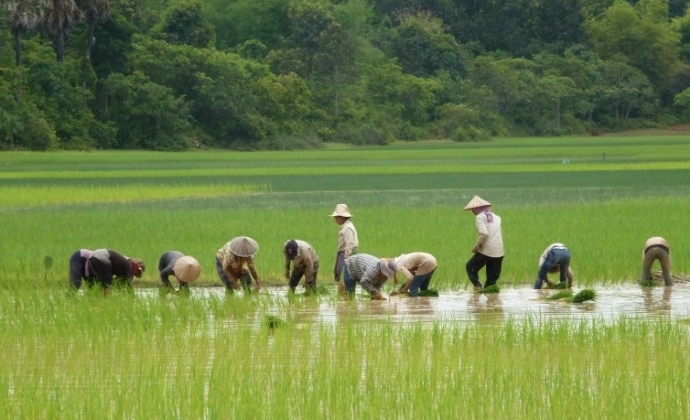
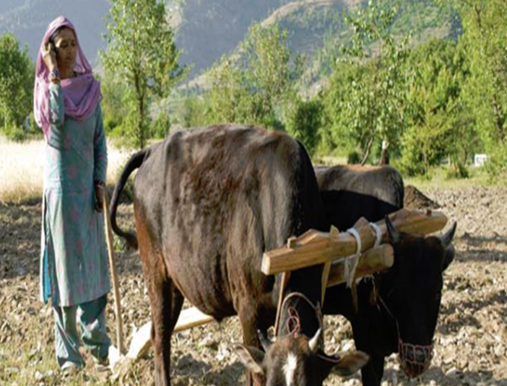
What are CABI’s activities
International Development
Plant health/IPM e.g. Plantwise: ~8m farmers reached
Invasive species management
Development communications & extension. e.g. Africa Soil Health Consortium
Trade & market access
Mobile outreach (~7m farmers reached via 21 services)
Partnerships
Knowledge Management & Content Curation
CAB Abstracts (11m records); Compendia, Books
Professional microbial services
Microorganism collection screening and supply; testing and consultancy services; microbiological identifications; preservation & patenting; next generation sequencing capability
Developing…
Nutrition-sensitive ag
Data analytics and pest risk modelling

Slide 28
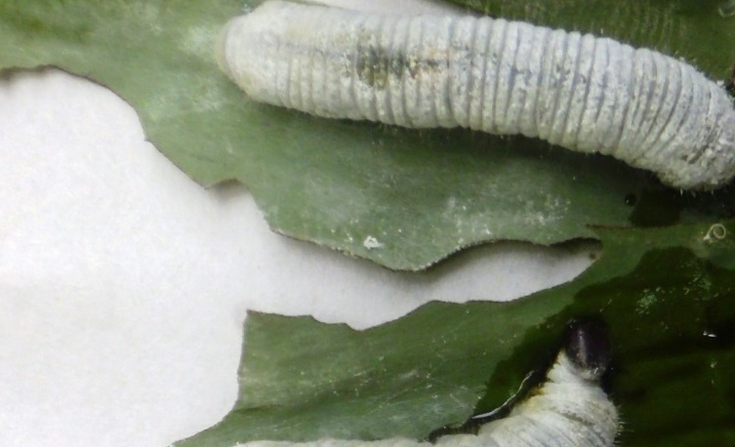
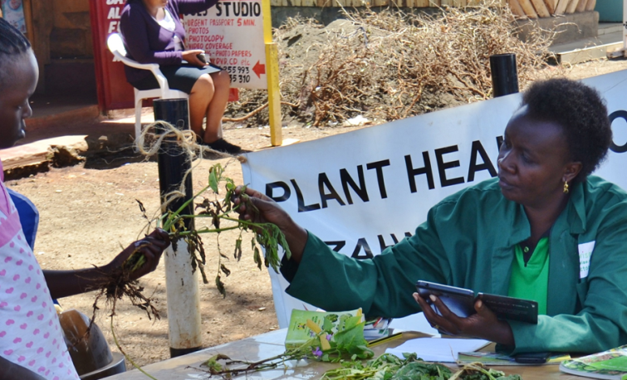
Project interests
Research that finds solutions to agricultural and environmental problems:
  improving food security to help alleviate poverty
  improving access to agricultural and scientific knowledge
  protecting biodiversity by managing pests and diseases
CABI seeks …
Collaboration with UK research institutes that have complementary interests.

Slide 29
What CABI can offer
Access to key ground truthing information through our project networks to inform research direction, particularly Plantwise, ASHC
Downstream activities relating to putting research into use (social research, partner engagement, dev. comms)
Facilitate network building between UK and African/Asia academics and other partners
Coordinate development of research facilities (eg. CABI-China Joint Lab, Tissue culture facilities in Malawi, Australia-Africa biosecurity partnership project)
Publishing educational and research materials
Training researchers how to access information including using information resource tools available (ISC workshops, info resource training)

Slide 30
Faustina Hwang
University of reading

Slide 31
Ensuring that computer technologies are usable by people with a wide range of capabilities, including people with:
Motor impairment
Sensory impairment
Cognitive impairment
Age-related conditions
Accessible computing
Digital health
Computer-supported health, wellbeing and rehab applications:
Dietary assessment
Personalised nutrition
Stroke rehabilitation
Dementia support

Slide 32
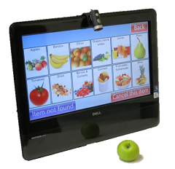



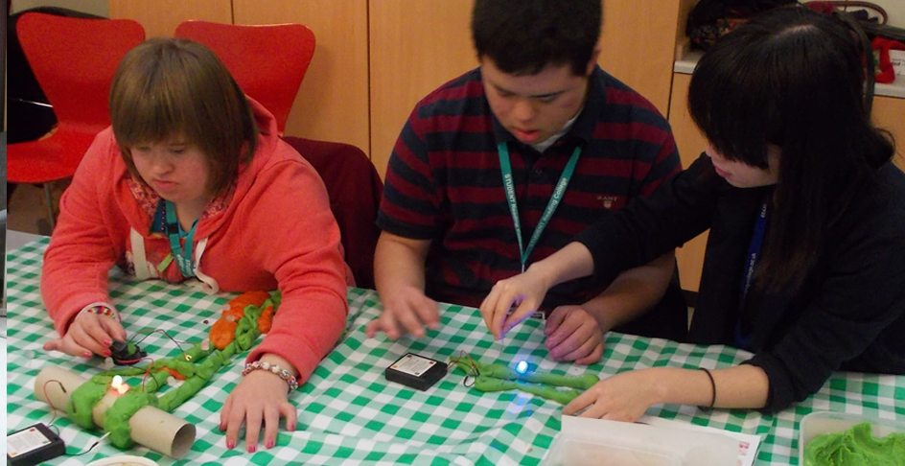
Technology for prospective recording of dietary intake
Personalised nutrition advice via a web-based food frequency and lifestyle questionnaire
3D virtual reality in education and skills training
Multisensory approaches to designing technology with and for people with learning disability

Slide 33

User-centred design
Field studies
Context
Build
Deploy
Design
(rinse and repeat)
Aim: to ensure that the technology is fit for purpose.
Bjarne Stroustrup, creator of the C++ programming language:
“I have always wished for my computer to be as easy to use as my telephone.
My wish has come true
…because I can no longer figure out how to use my telephone.”

Slide 34
Emily Black
University of reading

Slide 35
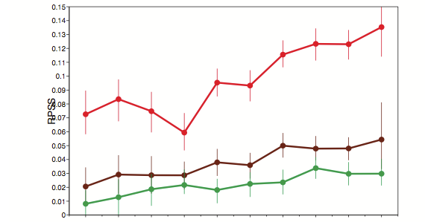
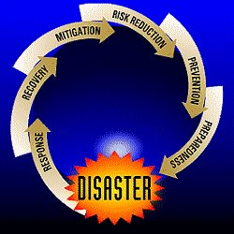
National centre for atmospheric science climate and weather divisions:
Official development assistance
Improvement in prediction
skill for 2m temperature
NCAS is investing in building
the capacity of developing countries
to exploit state-of-the art
weather forecasts and
sub-seasonal to seasonal forecasts
for early warning of adverse events
More
skill
Day 12-18
Day 18-25
Day 26-32
Foundation phase: October 2016 – July 2017
Proposed follow on:
July 2017 – June 2020
Less
skill
2002
2011
Vitart et al, 2013 ECMWF

Slide 36
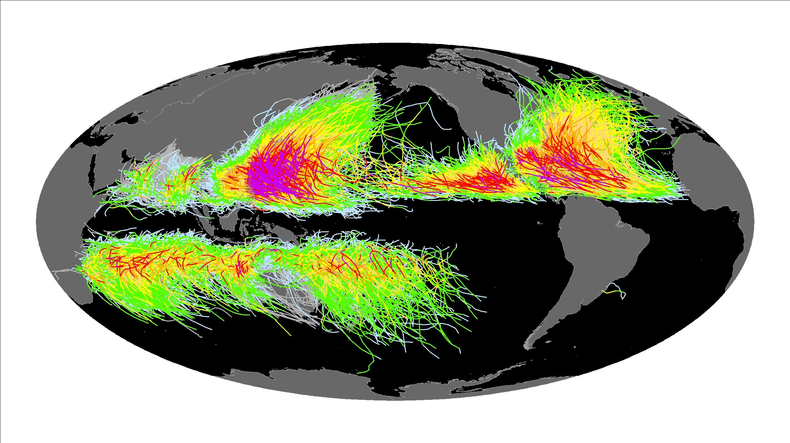
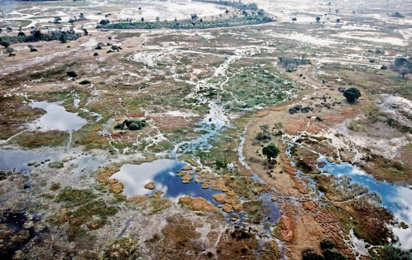
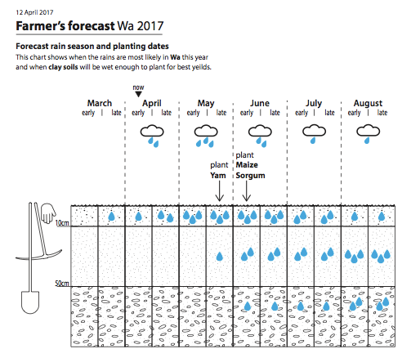
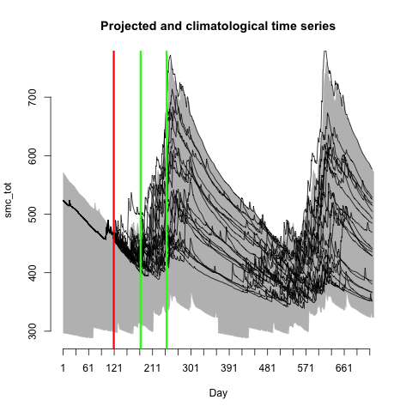
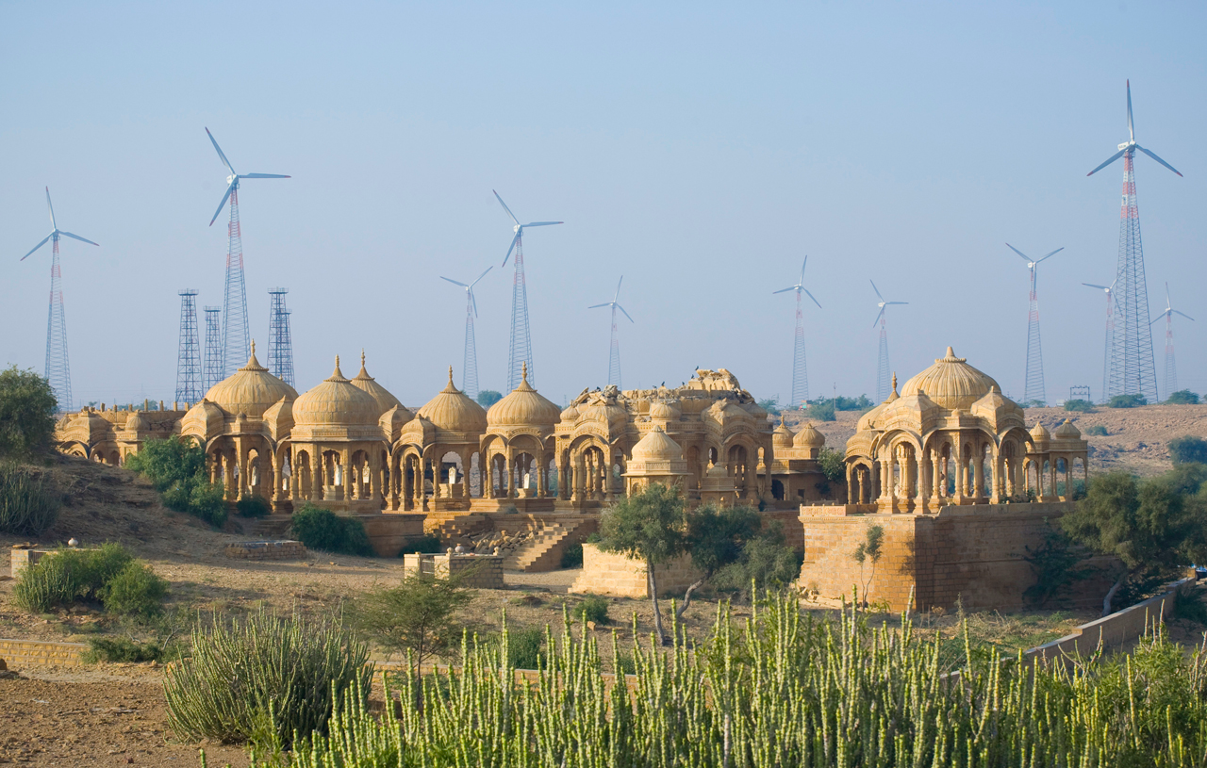
Areas of work
Agricultural drought
Extreme rainfall
Tropical cyclones
Renewable energy

Slide 37
Partners include:
National hydro-meteorological services (NHMSs)
  Ghana
  Nigeria
  Tanzania
NGOs / Industrial partners
  One Acre Fund
  Risk Shield
International organizations
  WMO
  ICPAC

Slide 38
Tristan Quaife
University of reading

Slide 39
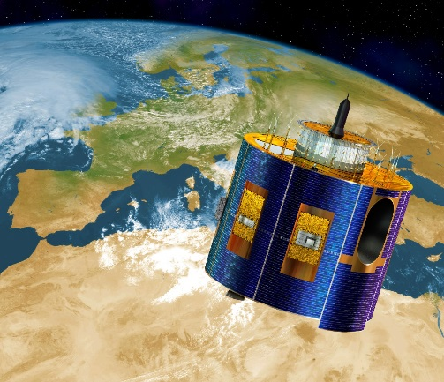
TAMSAT: The University of Reading’s operational rainfall product for Africa
Daily, five daily and ten daily cumulative rainfall estimates
  10-daily issued on the 1st, 11th and 21st of the month
  5-daily issued on the 1st , 6th 11th …
Monthly cumulative rainfall estimates
  issued on the first day of the following month
Seasonal cumulative rainfall estimates
  issued on 1st March, June, September and December
All products are 4km resolution for the whole of Africa
Date range 1983 - present day

Slide 40
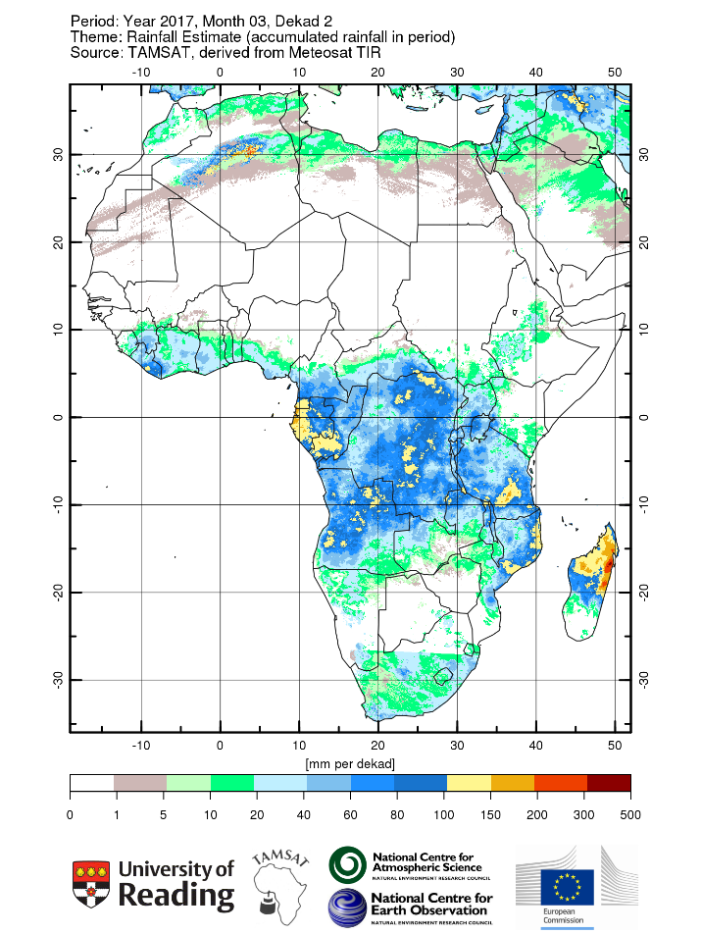
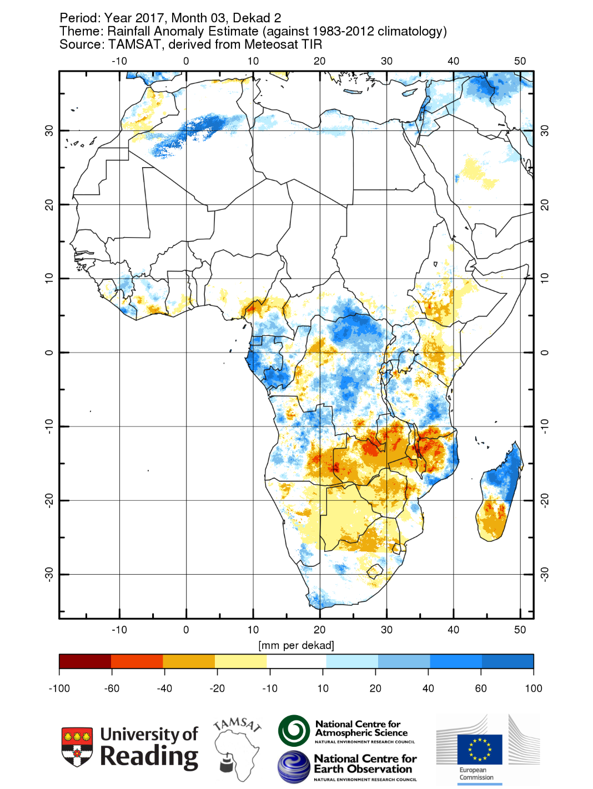
tamsat.org.uk
t.l.quaife@reading.ac.uk
e.c.l.black@reading.ac.uk

Slide 41
What can TAMSAT do for you?
Rainfall data for Africa
  Freely available from tamsat.org.uk
  Validation reports available
Advice on use TAMSAT data
  Suitability for specific applications – in common with other satellite data better for accumulated and spatially distributed rainfall
Partnering on GCRF (or other) project proposals
  Strong track record of attracting funding
    Leading ERADACS – a NERC GCRF Building Resilience project
    Current funding from NCAS, NCEO, NERC, Innovate UK, JRC, various PhD studentships.
  Willing to lead appropriate proposals

Slide 42
Deborah Hardoon
Oxfam

Slide 43
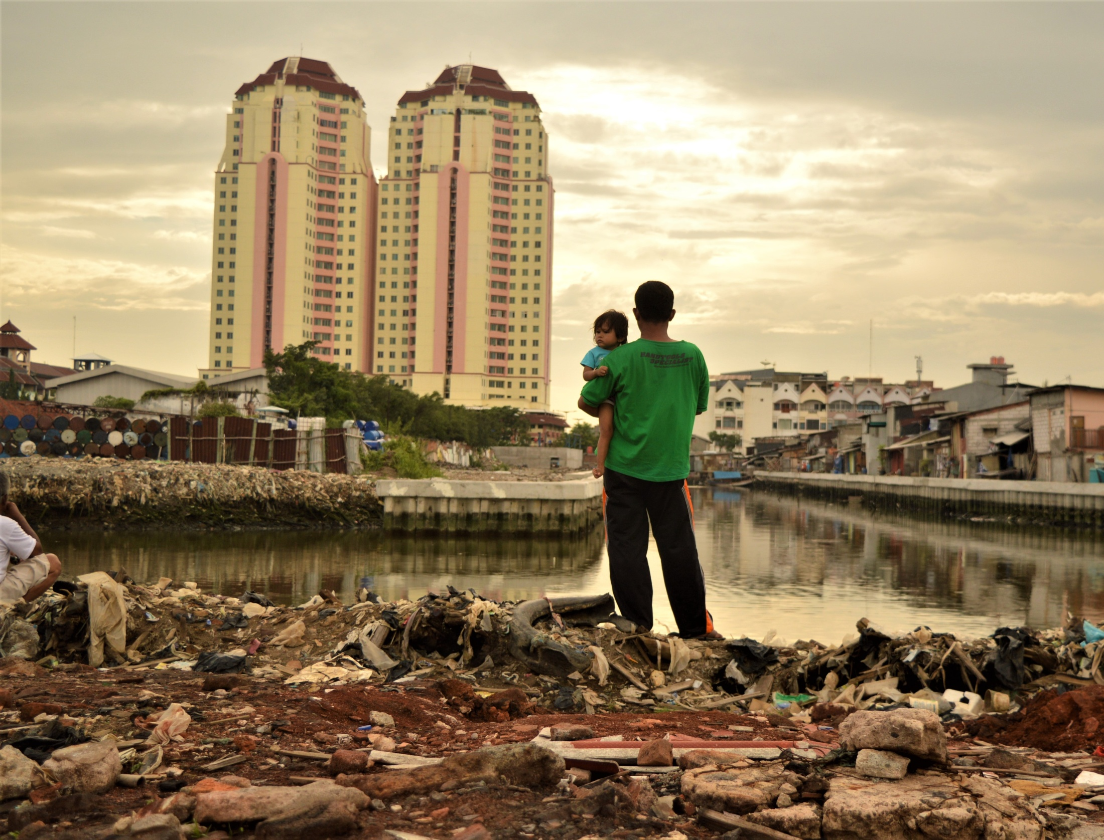
A father holds his daughter as he stands on a site where residents have recently been evicted from nearby luxury apartments in North Jakarta.
Photo Tiara Audina

Slide 44
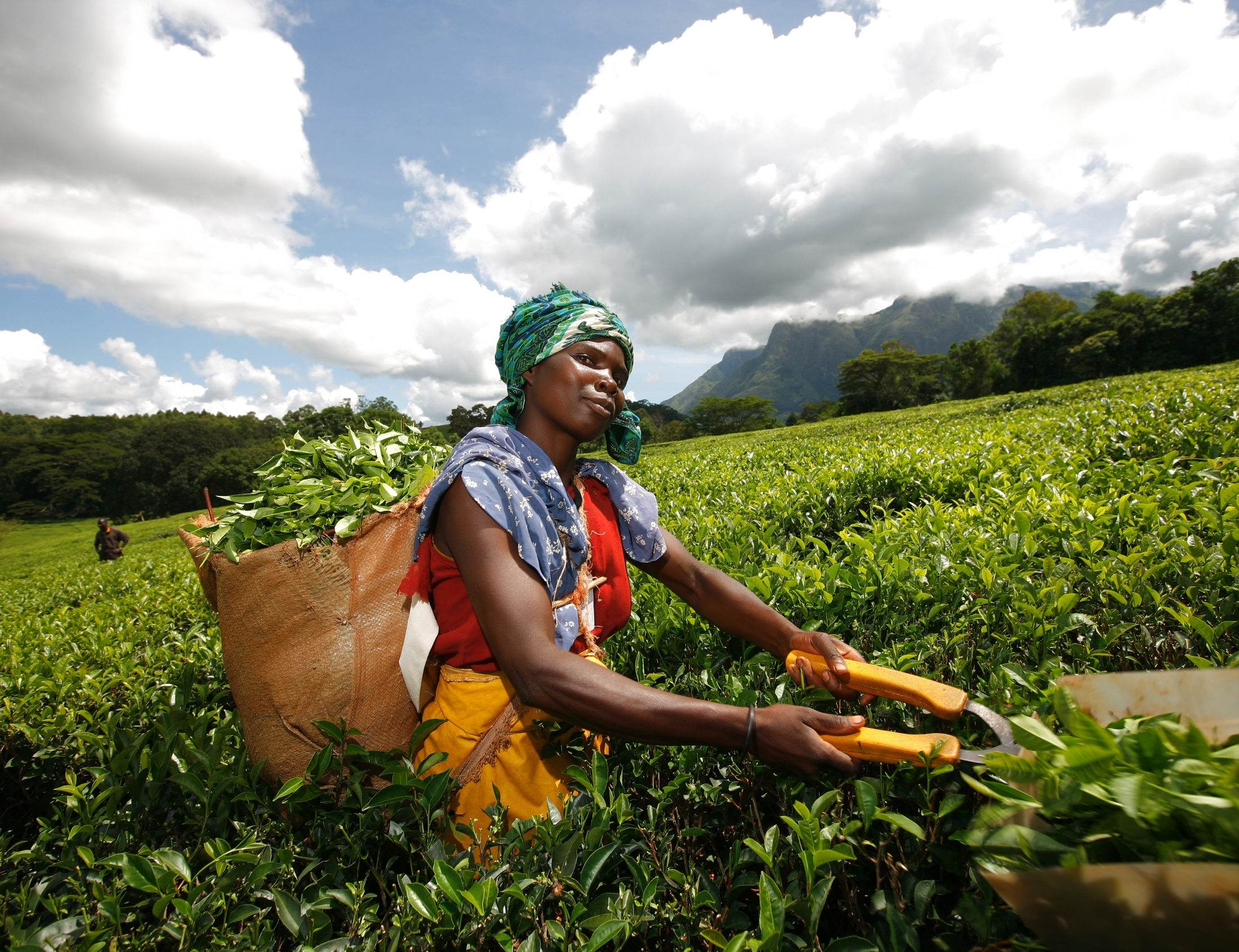
Tea picking in Mulanje, Southern Malawi. Workers are paid a day rate according to the weight of tea they manage to pick. For an 11 hour day they earn roughly £3.
Photo Abby Traylor-Smith

Slide 45
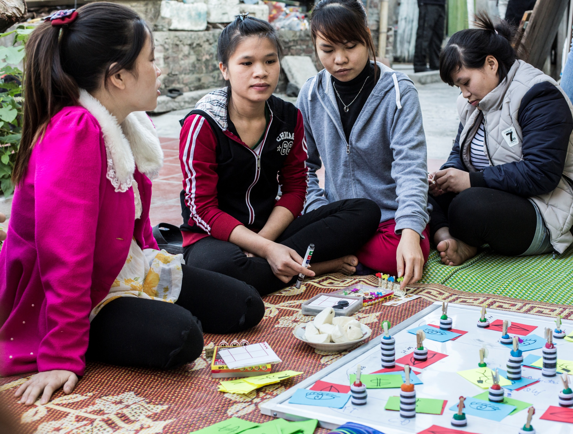
Oxfam works with CDI , Labour unions, Lawyers’ Association, and local authorities to empower migrant workers to claim decent working and living conditions in urban areas in Vietnam.
Photo Adam Patterson

