Slide 1
Pitch presentations
Afternoon session

Slide 2
Angelique chettiparamb
University of reading

Slide 3


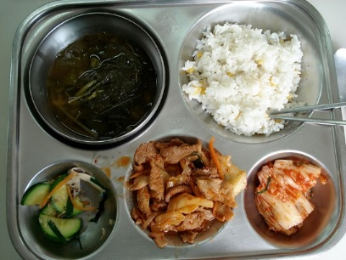
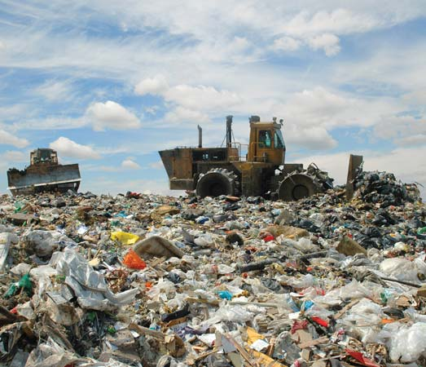
An overview of what I do
Mainly research in India, but also open to research in Africa.
Have looked at a range of topics, a sample of which are multi-scalar governance of :
I have also published on topics such as:
devolution, poverty, microfinance, gender, participation, social justice, public interest, conflict and T&L in higher education.

Slide 4
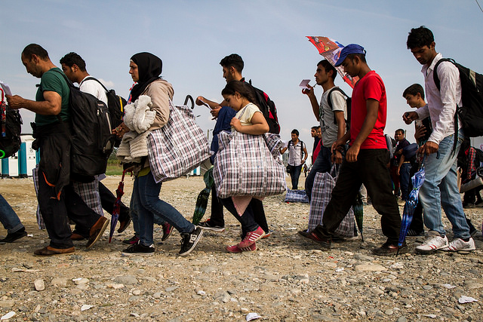
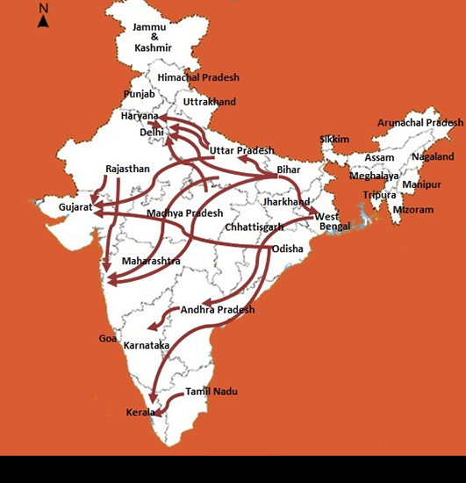
What projects am I considering
Investigation of intra-national migration within India into the state of Kerala: AHRC, but also ESRC.
  Networking application – drawing together already conducted research in universities in India.
  Cultural identity and linguistic barriers
  Pathways to access shelter and housing.
I need collaborators for the project on cultural identity and linguistic barriers.
I will also be collaborating with colleagues (finalised) on the housing project.

Slide 5


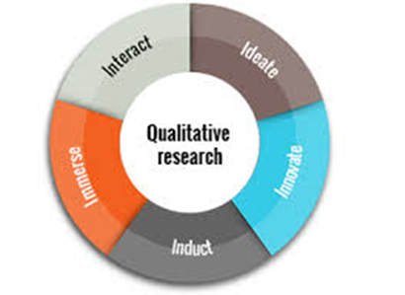


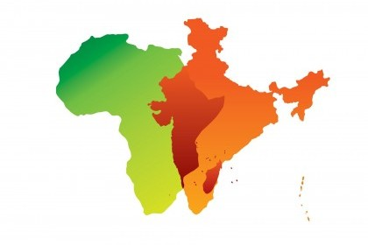

What I could contribute.
Practitioner turned theorist!
I am an architect –urban designer – planner.
But also interested in
Indian working in UK, but also interested in Africa.

Slide 6
YVAN BIOT
FARM AFRICA

Slide 7


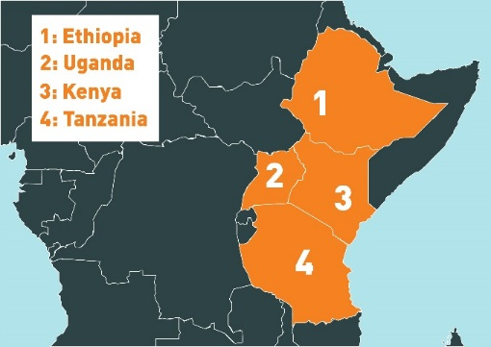



WHO WE ARE
FARM AFRICA is an action-oriented development NGO working
to bring prosperity to smallholder farmers in eastern Africa.
30 YEARS OF EXPERIENCE
$20 MILLION TURNOVER
SPECIALIST EXPERTISE
RANGE OF PROJECTS
UK Public
Agriculture
Crops
Forests
Natural resource management
Livestock
Rangelands
Market engagement
Aquaculture
Ecosystems
Institutional donors and corporates
$

Slide 8
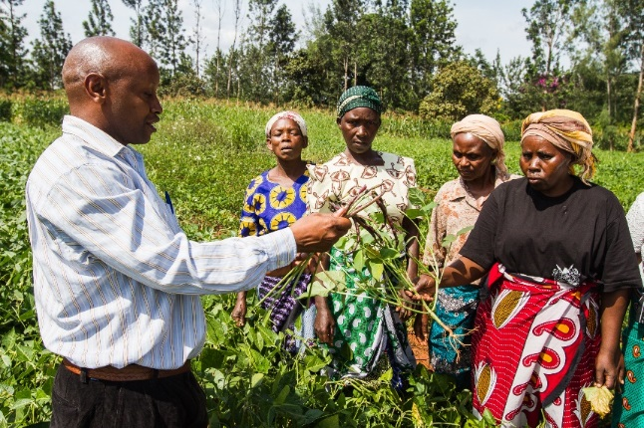
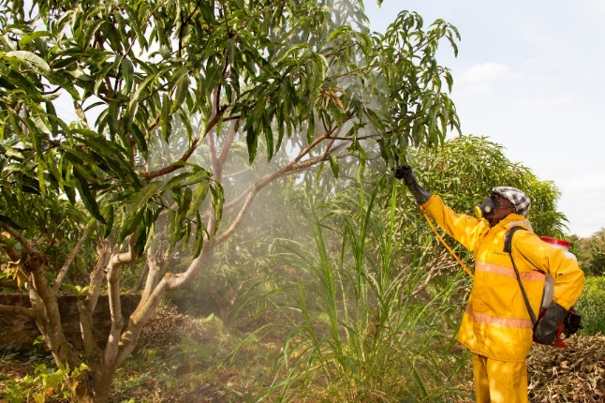
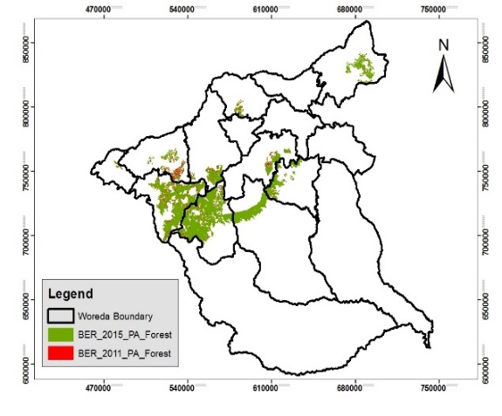

WHAT WE CAN ACHIEVE THROUGH RESEARCH / INNOVATION
Data collection and information exchange
Operational Efficiency
Develop new technologies
Effectiveness of our work
Production, pest control, climate forecasts, insurance, remote sensing - biomass
Impact assessment
Long-term impact (>M&E)
Does what we do produce the desired transformational change – human well-being and ecosystem health

Slide 9



WHAT WE CAN OFFER
Field projects in agriculture, forestry, aquaculture and livestock
Knowledge of local challenges
Local presence
Technical staff

Slide 10
Bhismadev Chakrabarti
University of reading

Slide 11

Bhismadev Chakrabarti
Professor of Neuroscience & Mental Health | Research Director, Centre for Autism

Slide 12
Current GCRF project remit
- Developing a mobile platform for autism risk detection in India (MRC Foundation Award, 2017-19)
Future (potential) project needs
- Machine learning & Big Data analysts
- Epidemiologists, Statisticians

Slide 13
For potential collaborators
Experience of leading a successful GCRF bid
Subject Matter Expertise:
  Mental health assessment/ interventions in low-resource settings [Global Mental Health]
  Behavioural, eye-tracking, psychophysiology studies of Autism and social behaviour
Close research collaborations in India
  6 institutions in 4 cities
  2 PhD students (Felix Scholarship funded)
Notes:
Familiarity with culture, languages, and institutions

Slide 14
Al Edwards
University of reading

Slide 15


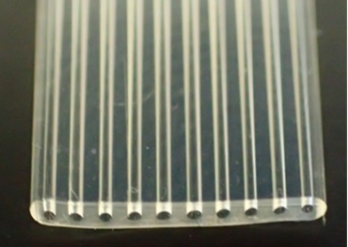
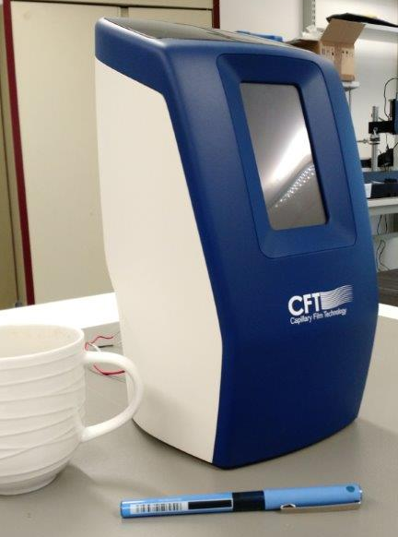

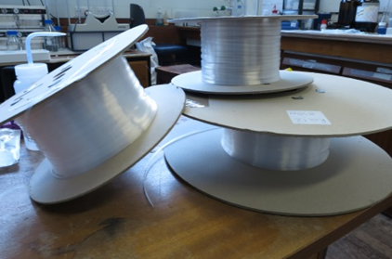


www.capfilmtech.com

Slide 16
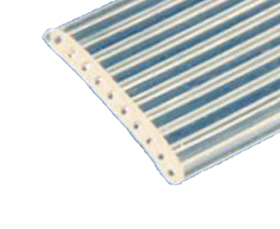
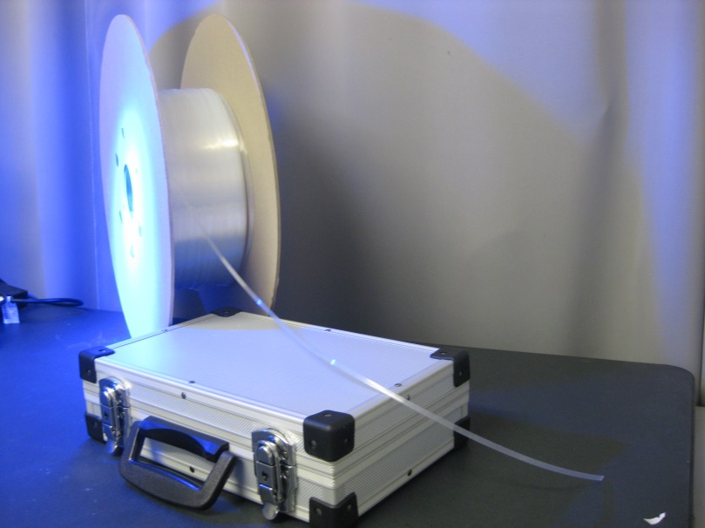
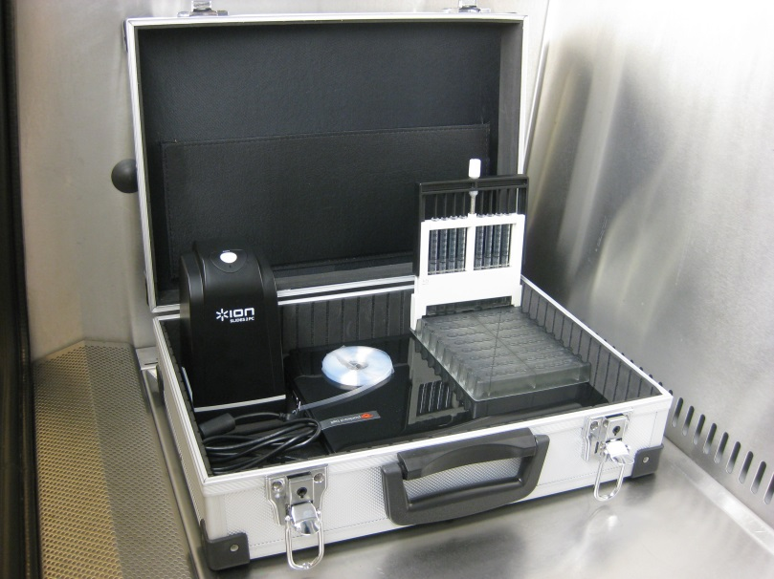
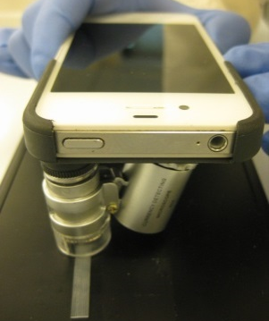
How to develop? FOR WHO? USER REQUIREMENTS? CLINICAL NEED?
AFFORDABLE or LMIC
IMMUNOASSAY Device concepts
Lab-in-a-Briefcase
Smartphone readable
Edwards, Reis et al 2011, 2014, 2015, 2016

Slide 17
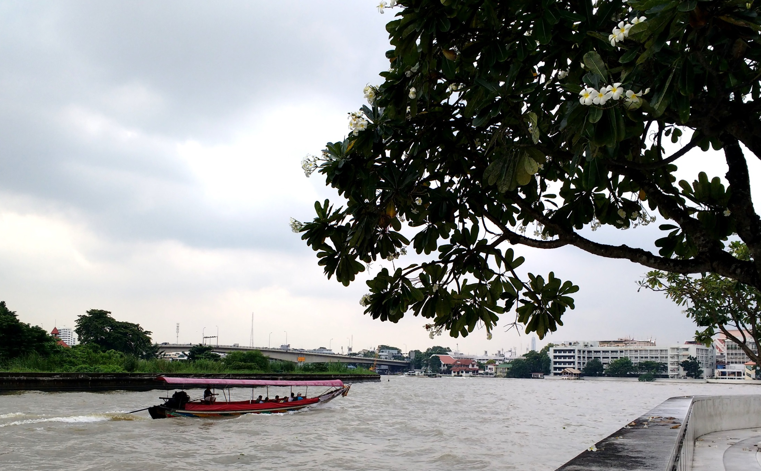
Current status: Wellcome postdoc in Bangkok: IT WORKS!
Answer: VISIT, funded by EPSRC Pump-priming travel award

Slide 18
Sean Mayes
Crops for the future

Slide 19
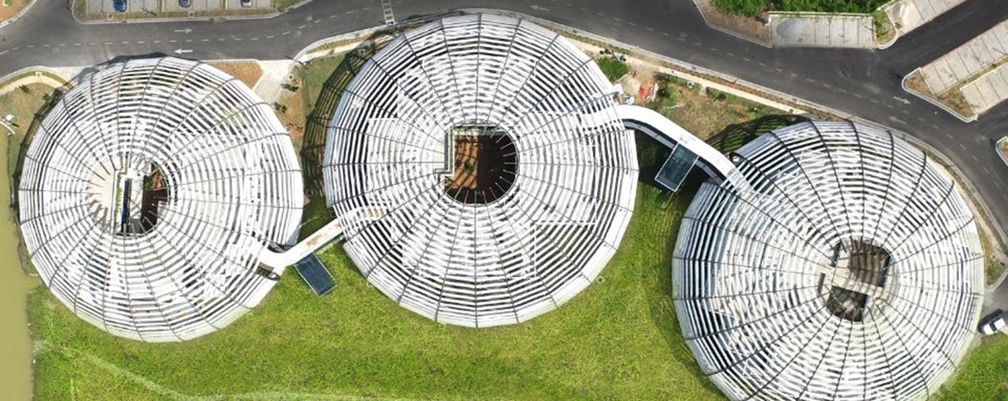
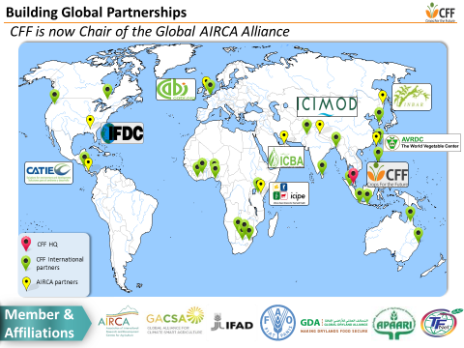

Crops for the Future – A research company with no shareholders
…based in Malaysia, with an international remit to carry out research
on underutilised crops
Dr Sean Mayes, Theme Leader Biotechnology and crop genetics

Slide 20
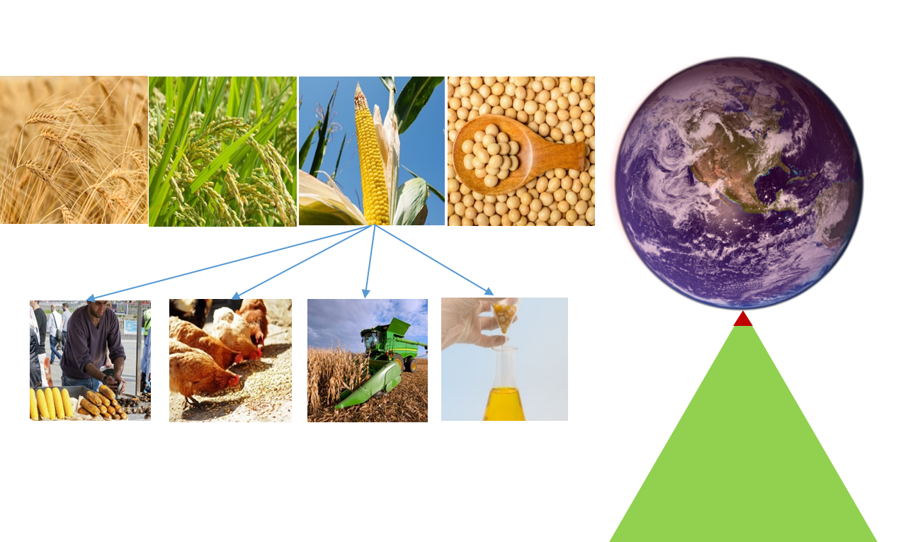
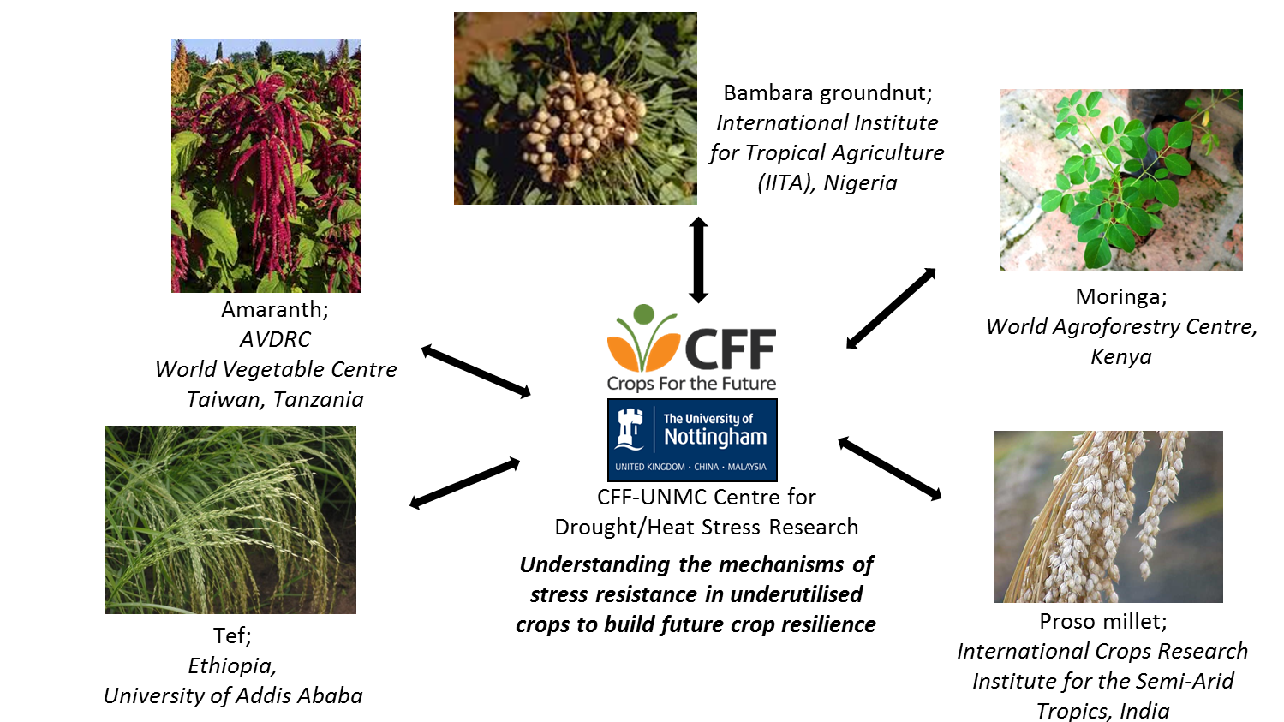
In addition, it makes sense to look back at some of the crops
that have been grown in low input systems for centuries
The world is very dependent on four major crops
…these crops alone are unlikely to provide food
and nutritional security for an increasing population
Can we resolve some of the issues which prevent
greater use of such underutilised crops?

Slide 21
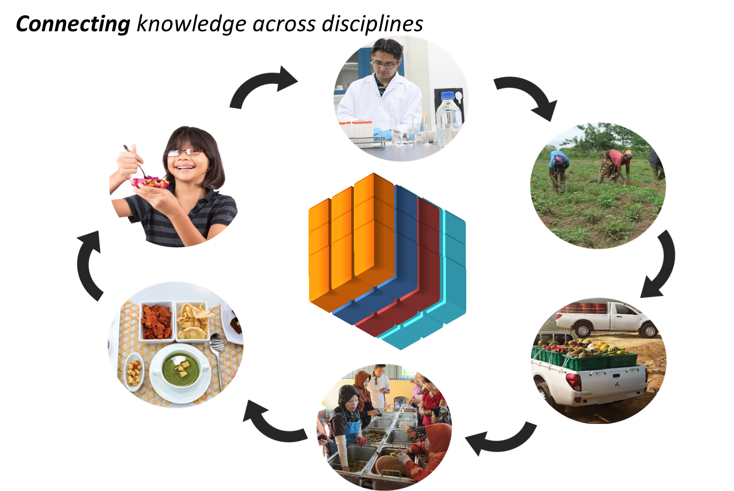
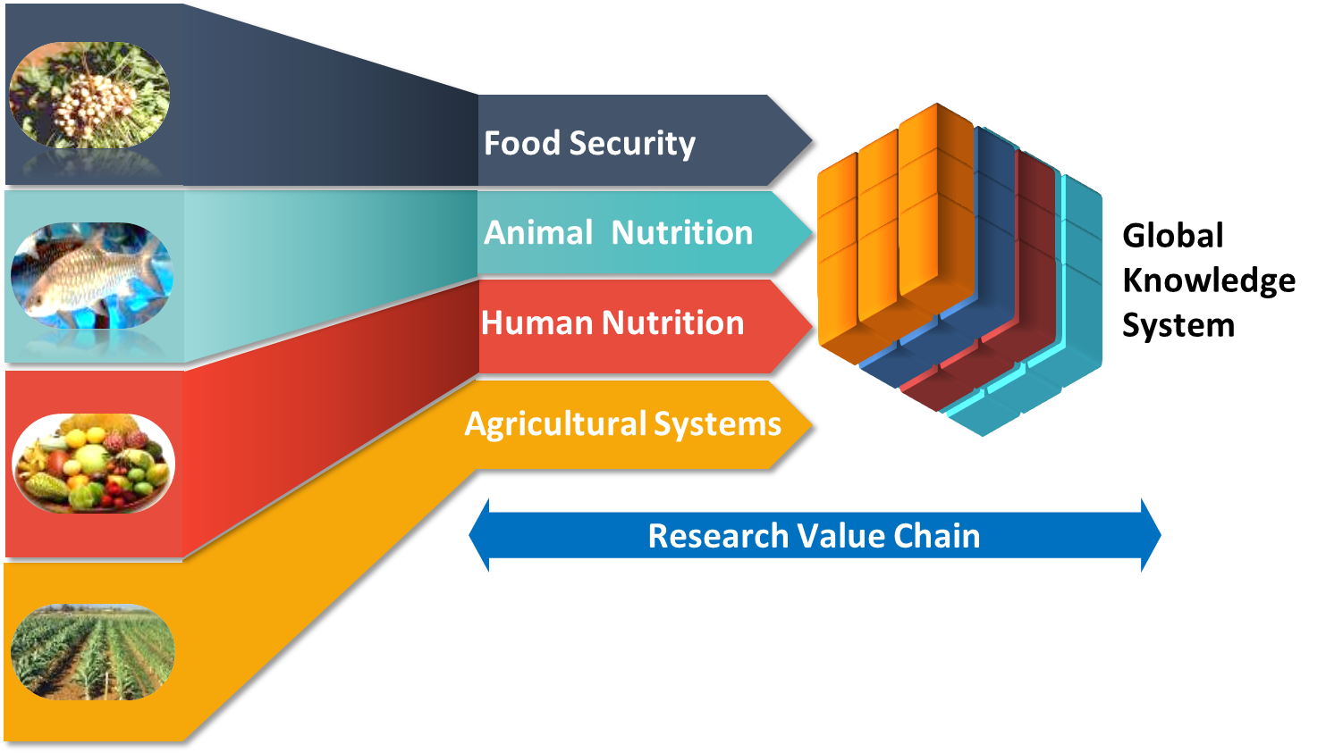
Using an integrated disciplinary approach to design and deliver research into underutilised crops…

Slide 22
Paz vaqueiro
University of reading

Slide 23






Materials for Energy Applications
Dr Paz Vaqueiro
Associate Professor in Materials Chemistry
Department of Chemistry
University of Reading
Reading RG6 6AD
UK
Group web pages:
http://www.personal.reading.ac.uk/~qf906281/

Slide 24
Energy from Waste heat
Thermoelectric Power generator
Heat Source
T+ΔT
h⁺
e⁻
p-type
n-type
Heat sink
T
Only a third of the energy in coal is converted into electricity.
In the UK, industry generates 10-40 TWh of waste heat, of which a significant fraction is released through cooling water streams and flue gases.
Simple solid-state device, containing two types of semiconductors

Slide 25
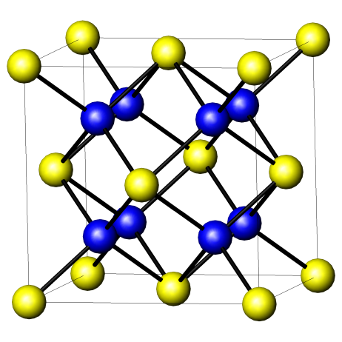
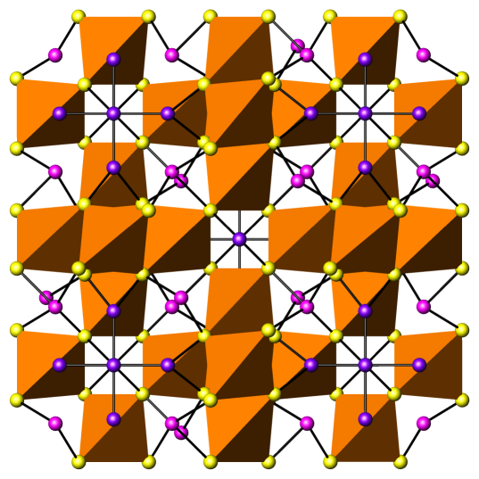
Need for new materials
Materials made at Reading:
Commercial thermoelectric material:
Bi₂Te₃ (doped) ZT ∼ 1 at 25°C
Bornite (doped)
Cu₅FeS₄
ZT∼ 0.8 at 280°C
Abundance of elements
Tetrahedrite (doped)
Cu₁₂Sb₄S₁₃
ZT ∼ 1 at 450°C
1 ppb in the Earth’s crust

Slide 26
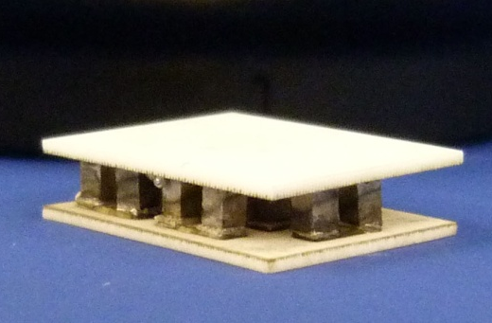
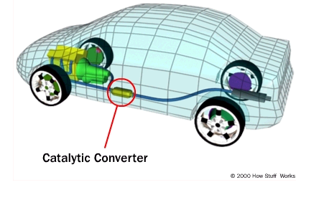
Automotive energy recovery
New car emission standards
160 g CO₂/km (2007)
130 g CO₂/km (2012)
95 g CO₂/km (2020)
Regulation (EC) No 443/2009 (2009)
Reading-Cardiff Module
Yb_{x}Co₄Sb₁₂ (n-type)
Ce_{x}Fe₃CoSb₁₂ (p-type)
Thermoelectric
Generator
1.5 W cm⁻³ power density ΔT=365 K
J. Electron. Mater., 42, 1369 (2013).
Thermoelectric materials
(Reading)
Thermoelectric modules
(Cardiff)
Engine modelling/
integration
(Loughborough)

Slide 27
Mark Tibbett
University of reading

Slide 28
Mark Tibbett – Professor of Soil Ecology
Plant-soil interactions
Soil (micro)biology
Rhizosphere
Mycorrhizal symbiosis
Zinc nutrition
Phosphorus nutrition
Carboxylate exudates
Roots
Soil organic matter dynamics
Soil phosphorus
Soil enzymes
Land restoration
Grasslands and pastures
(Agro) forestry

Slide 29
5 tonnes per hectare –
equivalent to 100 sheep
grassland – 20 times greater = 2000 sheep per hectare
Notes:
wheat field
grassland
leading to sheep analogy

Slide 30
Mycorrhizas
Form with most plant species
Colonisation occurs within the root
Enhance nutrient uptake
Protects against metal toxicity
Role in soil aggregation
Soil borne biocontrol agent: pathogen suppression
Form common mycorrhizal networks

Slide 31
Richard lamb institute for environmental analytics

Slide 32














We are the IEA
We are a world-leading applied research and development organisation
We focus on opportunities afforded by environmental data analytics to manage risk
We work across the university to solve environmental challenges
We work in partnership
We are a key part of 2020 Research Strategy enhancing impacts through:
  Knowledge Exchange
  Media and Communications.
  Training
  Commercially orientated approach
Notes:
Good Morning / Afternoon
My name is Richard Lamb and I am the Knowledge Exchange manager with the Institute for Environmental Analytics
You may not have heard of us as we are only 18 months old, but we are already doing quite well. We have core funding from HEFCE and as a partnership organisation we work with over 20 external organisations.
We are your perfect research partner!
We are a world leading research organisation that can handle Big Data challenges and are based here at the University
We use BIG data to help solve environmental challenges and manage environmental risks
We works across the university so we don’t care what department you are in, if you have a problem and you think we can help….we are not difficult to find…we are on the 4th floor of the Phillip Lyle building…so come and see us!
We work in partnership, we have over 20 organisation in our partnership – some of which you can see here.
Most importantly we are successful. In our first year we have drawn in nearly £1m in research funding and we want to share this success and our unique talents and skills with you.
We are a key part of the universities 2020 research strategy and have been set up to help enhance your research impacts so we would love to collaborate with you and be written into your bids. We not only have an excellent team of researchers, but very experienced bid writers, people like me that understand knowledge exchange, colleagues that can help and enhance your communication and deliver training and development events.
We are also commercially minded so if you think your research might have a product associated with it, come and talk to us as we are already in the process of setting up our first spin out. So come and talk to us

Slide 33

collaborations
AROUND University
Meteorology
  R&D projects (Energy Meteorology, NCAS, Data Assimilation, Earth Observation, Atmospheric Chemistry)
  PhD supervision
  Impact plans and impact case studies
  Training for SCENARIO PhD students
School of Archaeology, Geography and Environmental Science (SAGES)
Agriculture and Policy Development (and Agrimetrics)
Henley Business School
Construction Management and Engineering
Research and Enterprise Services
Knowledge Transfer Partnerships
Notes:
We love to talk and we have already been around a lot of the university and are involved in a lot of things, as you can see………..so maybe you have already had a conversation with one of my colleagues or have an existing collaboration. If we haven’t me you yet, we would really love to see how we can contribute to your research.

Slide 34


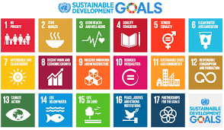
Already working on similar projects
http://the-iea.org/projects/re-sat-case-study/
Notes:
Coming back to GCRF, we are are already doing this!
We are working on a very similar funding stream from the UK Space Agency, the International Partnership programme.
We are collaborating with the Government of the Seychelles and the UNDP working to wrds acheiveig some of the UN sustainable development goals on a project we call ReSat.
This project aims to help reduce the islands reliance on fossil fuel for power by using our skills in Earth Observation and weather to identify sites suitable for the installation of renewable power sources.
We are bidding for a second round of funding to extend the programme to more small island states

Slide 35



Summary
www.the-iea.org
Institute for Environmental Analytics
Philip Lyle Building Room 406
Whiteknights Campus
0118 378 6820
Richard Lamb
r.lamb@the-iea.org
Maria Noguer
m.noguer@the-iea.org
We want to work with you
  We can contribute to
    Impact Plans
    BIG Data
    Research
  We have external business links
  We work across the university
  We have experience to share
  We love a good collaboration
  So lets work together…….
@env_analytics
the-institute-for-environmental-analytics
Notes:
We can help and we want to work with you…..
We are not hard to find. We have a great website, we are on social media and we are on the 4th floor of the Philip Lyle building over by the Harris Garden
We are lovely people, we will make you a nice coffee and we would love to talk to you.
@env_analytics
Linkedin.com/company/the-institute-for-environmental-analytics
www.the-iea.org
Institute for Environmental Analytics
Philip Lyle Building Room 406
Whiteknights Campus
0118 378 6820
Richard Lamb r.lamb@the-iea.org
Maria Noguer m.noguer@the-iea.org

Slide 36
Alex Arnall
University of reading

Slide 37
Global environmental change and migration
Environmental change (including climate change)
Human migration, resettlement and displacement
Mobility, life course and rural livelihoods
Alex Arnall
APD and GDRD
Environment and development
Resilience and transformation
Tourism and environmental
management
Community-based natural
resource management
Notes:
Me – APD and GDRC
Disciplinary training in human geography
Overall: global environmental change and migration
Underpinned by three inter-related research areas
Environmental change (including climate change)
Human migration, resettlement and displacement
Human mobility, life course and rural livelihoods
These three are substantial areas in their own right, but it’s where they connect and overlap that particularly draws my interest
Don’t want to box myself in – other things related to environment and development where I have publications

Slide 38


Funded research
International land acquisitions and livelihoods, Mozambique, 2015-16 (PI)
Flood-induced displacement and resettlement, Mozambique, 2011-13 (PI)
Perceptions of SLR and resettlement, Lakshadweep Islands and the Maldives, 2012-15 (Co-I)
Notes:
Past four years: I have brought into the University of Reading three externally-funded projects that have allowed me to work on these topics
The first two projects are BA Small Research Grants
They are about rural livelihoods and displacement
I was the PI on the BA projects
Independent researcher work in the field with small-scale farmers, NGOs and policymakers
The third project was funded by the Research Council of Norway
Say project name
This is a large international research project undertaken in collaboration with UCL, Manchester and TERI (India)
I undertook a fieldwork and advisory role on this project – played a central role

Slide 39
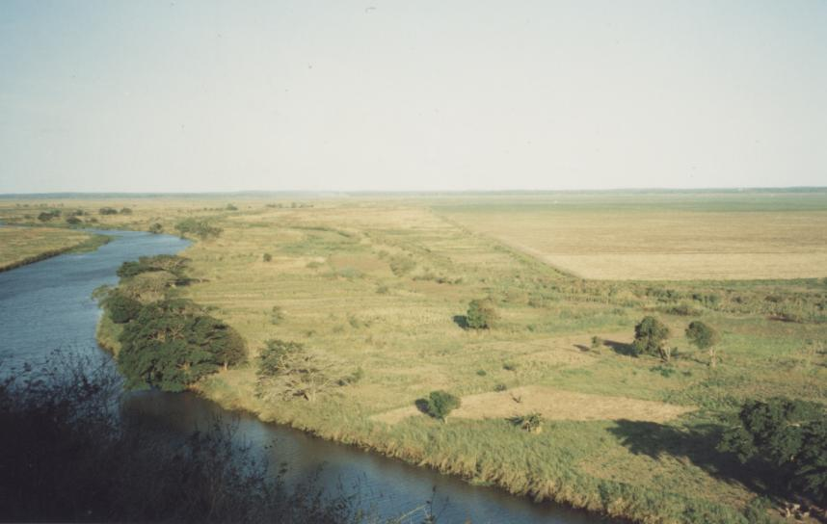




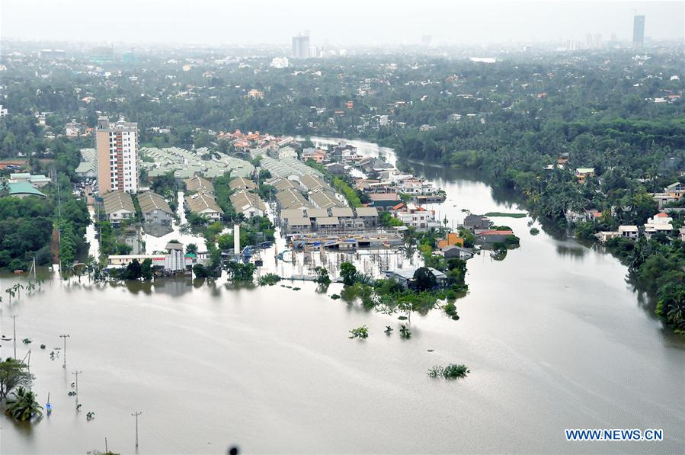
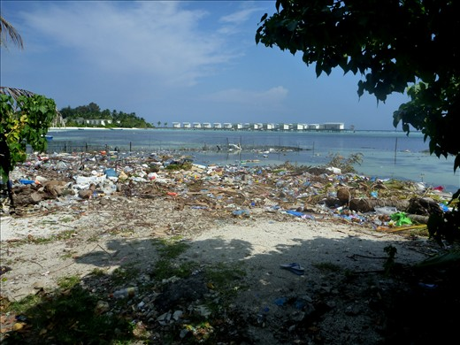


Going forwards
New countries
Urban contexts
Notes:
Work associated with SSA
Worth mentioning: I have had long-standing engagement with Mozambique
Worked primarily in the southern and central region of the country – primarily along the Zambezi River valley
I have worked with a number of international agencies
Also worked most recently in the Maldives
GOING FORWARDS
Interested in taking this work on GEC and migration to other countries
Also the urban context – this is a strength for Reading

Slide 40
Marie Nazombe self help Africa

Slide 41

Self Help Africa: our mission
Our vision is of an economically thriving and resilient rural Africa.
Our mission is to support sustainable livelihoods for Africa’s smallholder farmers.
Our goals for 2016-2020 are to work with rural communities to:
Improve food, nutrition and income security
Support agri-business
Improve the policy environment for smallholder farmers
Themes: Climate Smart Agriculture; Gender;
Social Inclusion; Youth; Innovation; Technology
Notes:
SHA focuses on agriculture and enterprise.
Investments in agriculture in sub-Saharan Africa are up to 11 times more effective at reducing poverty than investments in any other sector (FAO, 2012). The majority of Africans living in extreme poverty with insufficient access to food are, ironically, engaged in agriculture. Many of these smallholder farmers live in marginalised, diverse and harsh growing environments, with poor quality soil and limited irrigation options. They are reliant on increasingly inconsistent rainfall and lack access to agricultural inputs, finance, information and technology. Yet they are responsible for nearly all of Africa’s food production.
We also focus on agri-enterprise for two key reasons. The first is that smallholder farming is an extremely vulnerable livelihood. By investing in agri-enterprises we make livelihoods more resilient by increasing and diversifying rural household income streams. The second is that agricultural development is increasingly seen as key to sustainable and equitable economic growth in Africa. If matched with improved infrastructure, smart business and an enabling political environment, trade policies and a dynamic private agribusiness sector, the World Bank estimates that agriculture and agribusiness, together, could command a US$ 1 trillion presence in Africa’s regional economy by 2030 (World Bank, 2013).
Given that the majority of Africa’s poor are engaged in agriculture (World Economic Forum Agenda, 2013), it is difficult to imagine how equitable growth is possible without development in the sector. As Africa’s population continues to grow, agricultural development is imperative for the continent’s future food security. For these reasons, SHA focuses exclusively on agriculture and associated agri-enterprise.
Our goals are to work with rural communities to:
Improve food, nutrition and income security for smallholder farmers.
Support the establishment and growth of inclusive, profitable and sustainable agri-business.
Support improvement of the policy environment for smallholder farmers.
Our work is influenced by several over-riding themes which influence everything we do: 1) Gender and Inclusion 2) Youth 3) Climate Smart Agriculture 4) Innovation and Technology

Slide 42
Our impact
2012-2016
Notes:
Specific impact examples:
Northern Zambia: 20% increase in no. households with acceptable dietary diversity
Cashew value chain project in Benin: 21% increase in price per kg for cashew for Beninese farmers
In a climate resilience project in Malawi, 89% of farmers diversified their activities, making them more resilient
In Ethiopia we have supported Edget Farmers’ Union to supply 30% of improved wheat seed in the whole SNNP region. It now has an annual turnover of $1 million.
The Community Connector program in Uganda, part of USAID’s Feed the Future intiative, saw a 22% increase in children under the age of 2 having 3 meals a day.
*based on those surveyed, this is a weighted average for our poorest beneficiaries
**316,974 households (1,958,212 people) have increased their crop production by at least 25%. This equates to 79% of households with whom we are focusing on increasing production.

Slide 43

Self Help Africa: practice and research
.
1. Seed: We provide farmers with good quality,
drought tolerant and early maturing seed.
2. Training: We train farmers in sustainable,
climate smart agricultural practices.
3. Grouping: We group farmers together to form
strong farmer cooperatives.
4. Connecting: We link farmer
cooperatives to profitable markets.
Notes:
SEED: Including training seed businesses & coops, changing the policy in Ethiopia so small farmers’ seed can be accredited and sold, biofortification
TRAINING: Good agronomic practices, CSA, NRM, Gender Transformational Approach & Family Life Model, nutrition, Lead Farmer model, post-harvest handling, business skills
GROUPING: governance, finance, marketing, storage, bulking
CONNECTING: whole value chain approach, processing, value-addition, packaging
We are interested in any research that would improve the lives of the smallholder farmers we support, providing we have an existing programme to base it on, for example:
Climate smart agriculture strategies - e.g. the effect of legume inter-cropping on cassava yield and overall farm productivity
Ways to make productive use of agricultural waste products - e.g. bio-mass into fuel
Low-cost access to early warning systems for extreme weather events - e.g. localised predictions linked to mobile messaging with suggested adaptation strategies
Cost effective ways of tracking change and measuring impact - e.g. mixed methods approaches, better real time use of data
Behaviour change in agriculture/nutrition programmes - e.g. methods, drivers and level of adoption in communities to sustain change
Ways of reducing post-harvest losses

Slide 44
Vincent luo university of reading

Slide 45
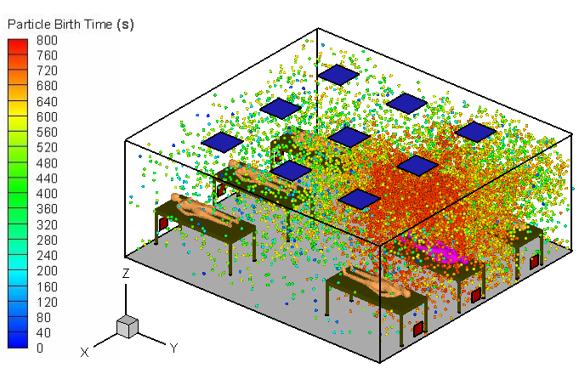
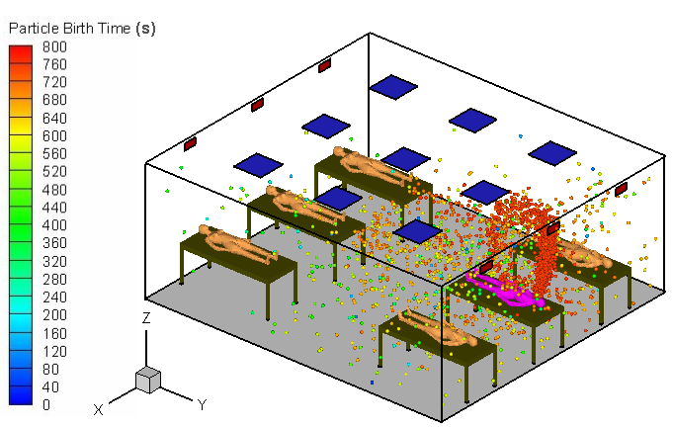
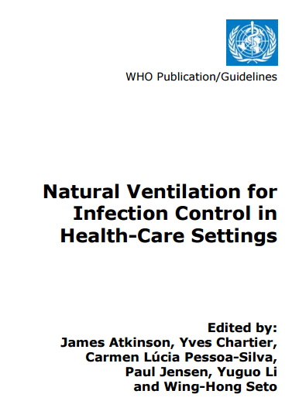
Health and well-being in indoor environment
CDC
Floor return
Building ventilation for in acute hospital environment
  First evidence to airborne influenza transmission
  WHO guideline on Natural ventilation for Health-care settings
  Human behaviour
New
ceiling return

Slide 46
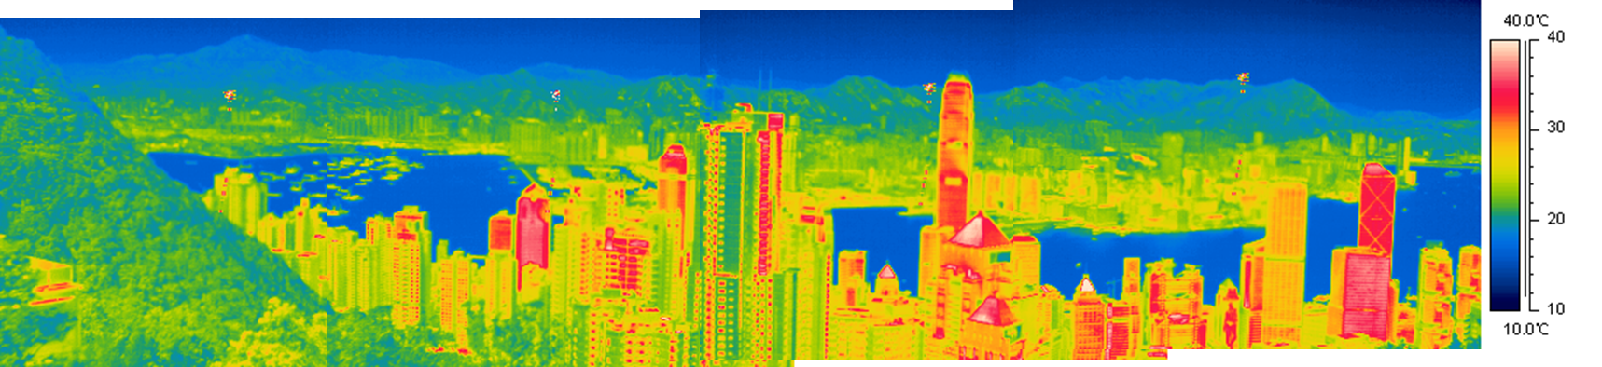
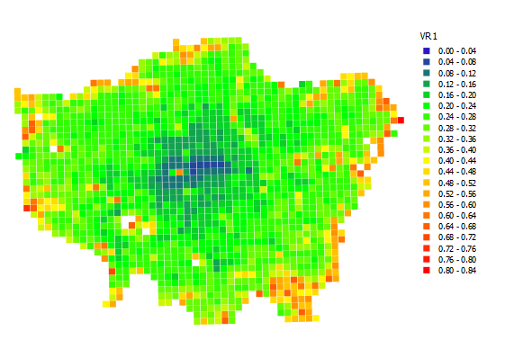
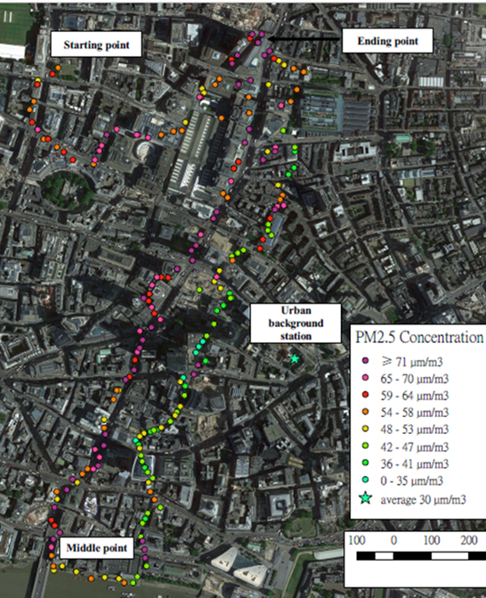
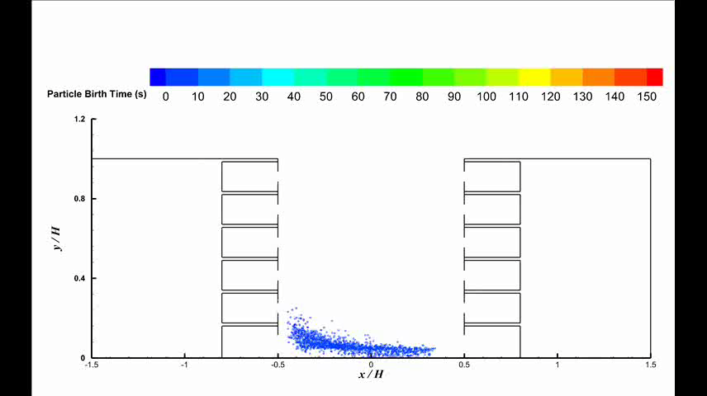
Urban microclimates and impact on indoor
Urban microclimates
  Urban wind/ventilation
  Urban heat island
  Urban pollution and exposure
  Indoor and outdoor interaction
  Prioritize interventions in Beijing (EPSRC-GCRF)
  Urban design: compact? interventions

Slide 47
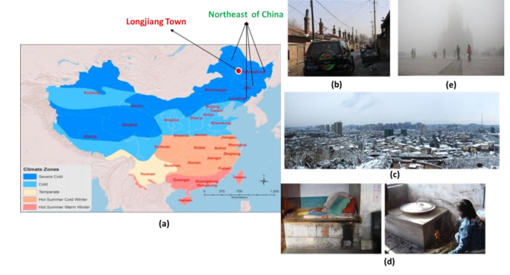
What I can contribute?
Indoor environmental design to promote health and wellbeing and prevent hazards;
Urban environmental design for better health and wellbeing
Good connections in China, Indonesia etc

Slide 48
Kleio Akrivou university of reading

Slide 49
Overview of my work – what I do
A number of disciplines study human collaboration that intersects the humanities and applied social sciences and psychology.
My work understands it as caused by personal and collective meaning making dynamics caused by varieties of moral (human) personality.
I discovered that opposite to the prevailing thought in the relevant disciplines there are three distinct varieties of human moral personality
  AUTONOMOUS: “SUBJECT”
    Autonomous
    (Autonomous)Processual
  INTER-PROCESSUAL: PERSON+SUBJECT+NATURE UNDERSTOOD IN BALANCE FROM WITHIN “PERSON” FUNDAMENTAL.

Slide 50
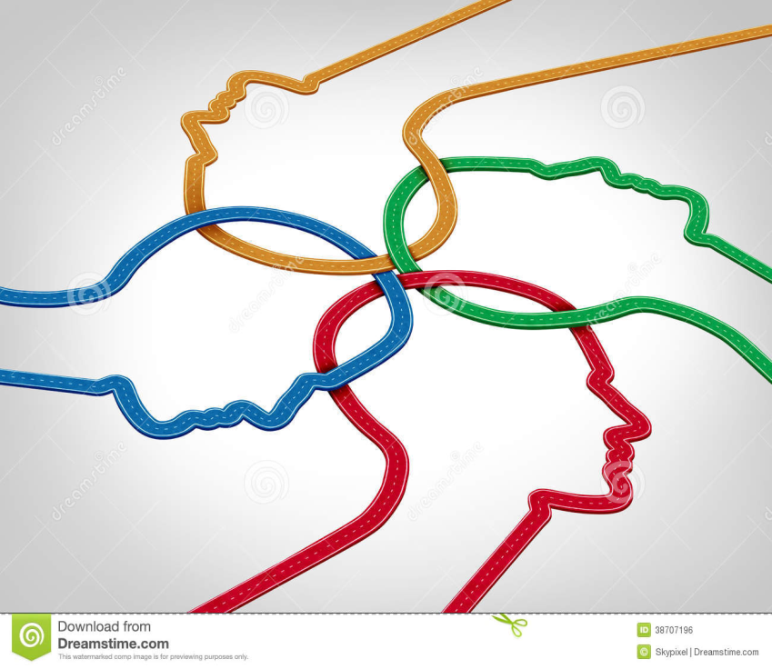


AS
(A) PS
IPS

Slide 51

Projects of interest
My work now aims to test and apply this novel theory with the purpose to address governance and societal challenges aiming for ethically binding frames of human collaboration at levels of action that are currently in “dead end” due to GOVERNANCE VACUUMS
Global or cross-national (cross-institutional) governance challenges: environmental degradation, peace and stability, the creation of global ethical norms, a blueprint for cementing global collaboration

Slide 52
Valued collaborators
Methods experts:
Experimental Study design and Measurement experts e.g. personality and social psychology and human decision processes
Experienced qualitative researchers e.g. in narrative analysis and in ethnography methods
Experts in applied Social and Environmental sustainability global policy and challenges e.g.. relevant to the UN / Global Compact goals. OR,
Experts in Global Politics and Governance with research expertise in various sub-areas e.g.. immigration, peace and security, global governance

Slide 53
Andrew Ainslie university of reading

Slide 54
Optimising the use of ‘smart’ technologies for household nutrition and food security in the Lake Victoria Basin
Dr Andrew Ainslie
Agriculture, Policy and Development,
and Walker Institute
a.m.ainslie@reading.ac.uk

Slide 55
Our research - done through the Walker Institute for the Future Climate for Africa (FCFA) programme - confirms that the majority of rural Ugandans engage in rain-fed, self-provisioning agriculture, (with protein from fish catches for lakeside communities also important)
As a result, people are at the mercy of a range of drivers of change (including climate risk, economic shocks, demographic pressures and weaknesses in governance structures across multiple levels)
The strong inflows of people into the Lake Victoria Basin over the next 20-30yrs are expected to ramp up population pressure on land, agro-ecological and fishing resources
This will likely place household food and nutritional security – and institutional capacity and quite likely also the rule of law - in the districts of southern Uganda under serious strain
But people are more connected than ever via mobile telephony and many ‘smart’ technologies already exist that could ease the potentially problematic shifts – these include a whole range of technical, informational, geospatial and institutional innovations to lever strategic efficiencies across the food system

Slide 56
The purpose of this research is thus to explore what technologies are in use, what works and why in relation to the uptake of innovations in the food system.
The focus will be on delivering significant food and nutritional security gains for all social categories of marginal people, but with particular emphasis on female, maternal and infant health and well-being
And to investigate how ‘smart’ technologies can further enhance household food and nutritional security across southern Uganda and conduct field trials to test how these technologies can be used at scale and at much higher population concentrations in future
Working with local partners in Uganda and UK-based technology developers/ providers, the project will focus both (i) on ‘smart’ technologies (such as mobile telephony, satellite-derived data, the use of UAV (drones), health smartcards, GPS-based tenure management systems, water-use efficient, ‘precision’ agricultural technologies, etc.)
and (ii) on institutional innovations (land registers, data repositories, etc) that have the real potential to optimise food and nutritional security in the Lake Victoria Basin.
Anyone interested in funding or getting involved in the project, should please contact me: a.m.ainslie@reading.ac.uk

Slide 57
Networking session
Secure and resilient food systems supported by sustainable marine resources and agriculture
Sustainable health and well being
Inclusive and equitable quality education
Clean air, water and sanitation
Affordable, reliable, sustainable energy
Sustainable livelihoods supported by strong foundations for inclusive economic growth and innovation
Resilience and action on short-term environmental shocks and long-term environmental change
Sustainable cities and communities
Sustainable production and consumption of materials and other resources
Understand and respond effectively to forced displacement and multiple refugee crises
Reduce conflict and promote peace, justice and humanitarian action
Reduce poverty and inequality, including gender inequalities

Slide 58
School of Agriculture, Policy
and Development
Agriculture
Food
Health and nutrition
Giacomo Zanello ^{1,2}
¹ University of Reading (UK)
² LCIRAH Fellow

Slide 59

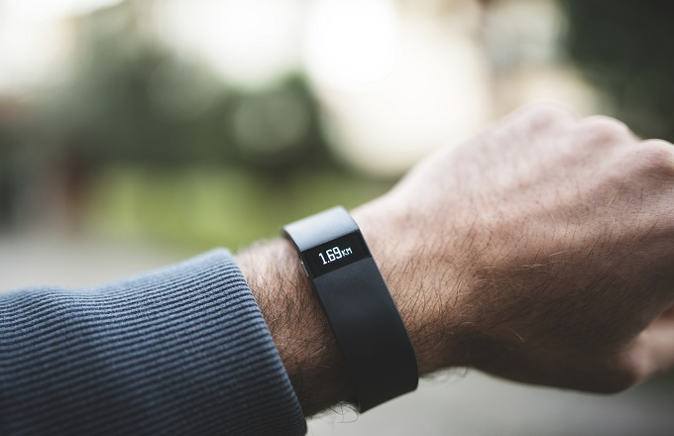
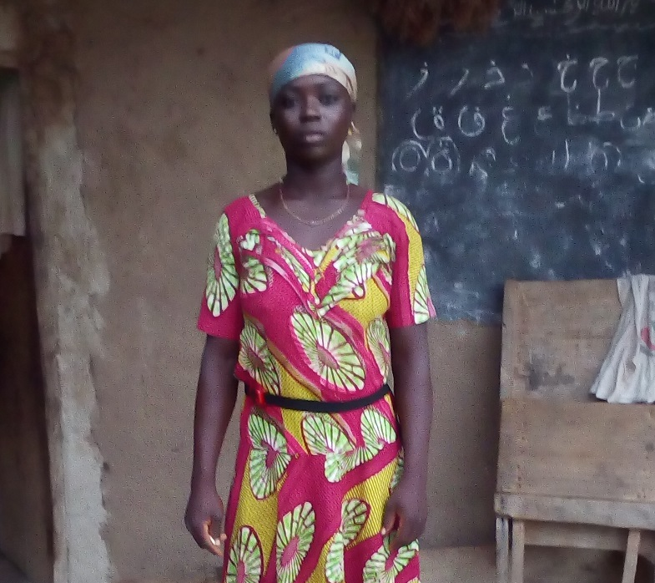
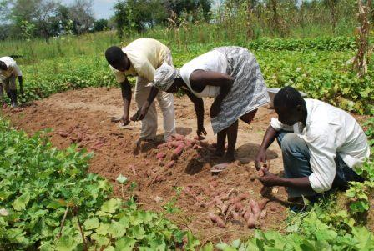

Slide 60
USE OF ACCELEROMETRY DEVICES
IN LOW-INCOME COUNTRIES
Physical activity, energy expenditure and time-use in agricultural and rural livelihoods
School of Agriculture, Policy
and Development
Giacomo Zanello^{1,2}
¹ University of Reading (UK)
² LCIRAH Fellow
Co-authored with C.S. Srinivasan (University of Reading), Prof. Patrick Webb (Tufts University),
Paul Nkegbe (UDS), Radhika Cherukuri (NIRD)

Slide 61
Pilot in Ghana
(Summer 2016)
40 Individuals followed for
5-days
20 Males
20 Females
18 Households
Energy expenditure
Time-use
Physical activity
Notes:
Overview – Narrative
Pilot’s objective: Potential use of accelerometry devices in empirical measurements in agri-rural livelihood activities

Slide 62
Distribution of Physical Activity Level (PAL) by gender

Slide 63
Mean PAL for men and women through the day

Slide 64
Time use pattern through the day – men
Time use share of activity (%)
Hours of the day
Notes:
Individual → Personal

Slide 65
Time use pattern through the day – WOmen
Time use share of activity (%)
Hours of the day

Slide 66
Main findings
Daily energy expenditure for both men and women is substantially lower than the poverty line in Ghana
Women consistently maintain higher physical activity levels than men through the course of the day
Men and women spend a similar proportion of their time on economic activities – the greater proportion of time that women spend on domestic activities appears to involve a trade-off against opportunities for social interactions
Working Paper: https://sites.google.com/site/gzanello/WP_zanello_srinivasan_nkegbe_2016.pdf
Notes:
Daily energy expenditure for both men and women is substantially lower than the norm (2,900 kcal per day) used for computation of the poverty line in Ghana
Overall daily energy expenditure for men is greater than for women, however women consistently maintain higher physical activity levels than men through the course of the day
Men and women spend a similar proportion of their time on economic activities – the greater proportion of time that women spend on domestic activities appears to involve a trade-off against opportunities for social interactions

Slide 67
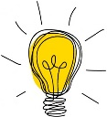
TIMELINE
  Fall 2015: Idea!
  Contacted potential collaborators in various Universities
  Unsuccessful large grant application I
  Explored collaborations with the industry
  Spring 2016 - RETF University seed-funds: Small grant to run a pilot in Ghana in collaboration with a long-standing colleague
  Explored collaborations with NGOs
  Summer 2016 - EPSRC Seed GCRF: Collaboration with colleagues at Biomedical Engineering Dept. to better understand the technicalities of accelerometry devices and expand the geographical focus to India (EPSRC Seed GCRF)
  Unsuccessful large grant application II
  January 2017 - DFID (IMMANA Grant): Scale-up funds for a large scale multi-country all-year data collection

Slide 68
WHAT I HAVE Learnt
Pilot your idea!
Importance (and challenges) of communicating across environments
Multidisciplinary is an asset
Importance of personal network
Nurture relationships
Importance of support
‘Improvise, adapt, overcome’
Notes:
Persevere

Slide 69
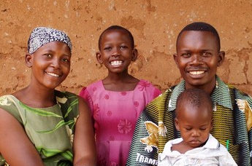
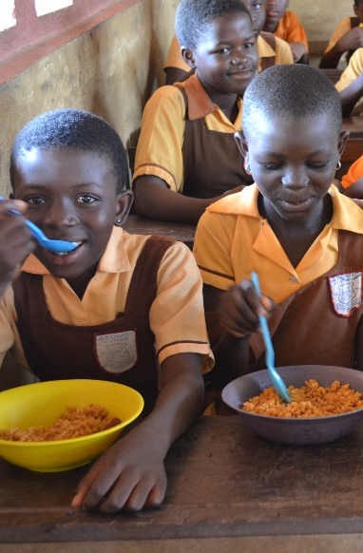
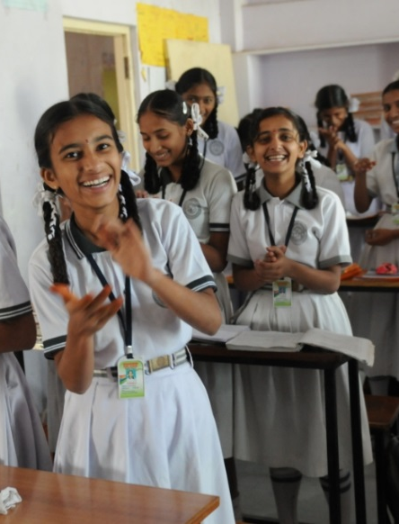
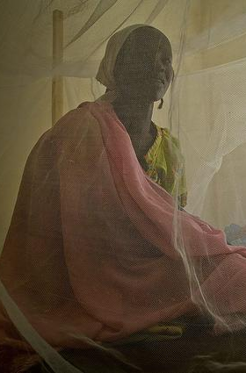
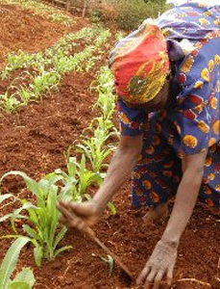


WHAT IS NEXT?
http://www.schoolsandhealth.org | http://www.thebetterindia.com | http://images.medicaldaily.com | http://www.independent.co.uk | http://www.theeastafrican.co.ke

Slide 70
USE OF ACCELEROMETRY DEVICES
IN LOW-INCOME COUNTRIES
Physical activity, energy expenditure and time-use in agricultural and rural livelihoods
School of Agriculture, Policy
and Development
Giacomo Zanello ^{1,2}
¹ University of Reading (UK)
² LCIRAH Fellow
Co-authored with C.S. Srinivasan (University of Reading), Prof. Patrick Webb (Tufts University),
Paul Nkegbe (UDS), Radhika Cherukuri (NIRD)
Working Paper:
https://sites.google.com/site/gzanello/WP_zanello_srinivasan_nkegbe_2016.pdf

Slide 71
interdisciplinary research projects
Case Study – brave
Building understanding of climate variability into planning of groundwater supplies from low storage aquifers in Africa
Professor Rosalind CORNFORTH, Director – The Walker Institute

Slide 72
The walker way
Prioritizing interdisciplinarity and multi-sector participation, especially at national level
  Activities should be led by partnerships to support and invest in equitable relationships
Recognizing the need to understand need and related want for interaction in partnership with local actors
Focused development of capacities/ provide strategic support to existing systems
Share evidence-based expertise, add long term perspectives to put in place today – e.g generating climate risks at multiple time scales
Ensure adaptive management approaches exist (structured and iterative)
Empower community approaches and voices to strengthen action at household, community and national levels

Slide 73





Within the African context:
Diverse People & cultures
Notes:
culture, history, economy, institutions, politics, natural resources, conflict & stability

Slide 74

Diverse Groundwater
2012: first quantitative
continent-wide maps of aquifer storage and potential published
0.66 million km³ of storage (not all available for abstraction)
Groundwater storage
(Source: MacDonald et al, 2012)
Notes:
Maps – promote more quantitative approach
Storage (inter-annual storage & natural buffer against climate variability & drought) (comparison – Rainfall – 0.02 m km3; Freshwater in Lakes – 0.03 m km3);
Large sedimentary aquifers in Libya, Algeria, Egypt & Sudan
Many countries can support handpump yields (0.1 to 0.3l/s), some potential for higher yielding boreholes (>5l/s). Cannot assume high yielding boreholes for widespread use for irrigation or urbanising cities. But there are high borehole yields in the thick sedimentary aquifers (particilarly unconsolidated or poorly consolidated sediments)
Good hydrogeological maps and studies for much of southern Africa, but lack of qualitative hydrogeological maps for north, west and central Africa. Small studies exist notably for Nigeria and Ghana
Notes: Uncertainly range 0.36 to 1.75; specific yields (drainable porosity) about half of measured porosity
….
-

Slide 75

Diverse Geology
Given this inherent diversity of land cultures and people, coupled with the complexity of the science, an interdisciplinary approach to designing, approaching and understanding the research questions is vital
Notes:
Geology
Groundwater depends on geology, geomorphology/weathering and effective rainfall (past and current)
Complex hydrogeological environment with variations in how much water is held, how thick the water bearing layers are, how water moves and how it is recharged. (innumerable variations in aquifer transmissivity, effective porosity, saturated thickness and groundwater recharge).

Slide 76


Interdisciplinary case study: brave project
BRAVE: Building understanding of climate variability into planning of groundwater supplies from low storage aquifers in Africa
THE BIG IDEA
We can build better ways to model and communicate the complex environmental changes in the Sahel region of West Africa and use that to improve the long term planning of groundwater supplies and provide early warnings of groundwater shortages so that the most vulnerable families and communities are more resilient to drought.
RESEARCH AIM / HYPOTHESIS
That by using integrated governance, the long term use of groundwater can reduce the vulnerability of poor people in the Volta River Basin, in West Africa, in the face of a variable climate and changes to the local environment, society and economy.

Slide 77
Brave interdisciplinary work packages (WP)
WP5 Delivering Evidence and Demonstrating Resilience
WP1 Understanding Vulnerability (Past, Current, Future)
WP4 Improved strategic planning and adaptive capacity
WP3 Improving understanding of the hydro-climate
WP2 Understanding Decision-making Pathways, Governance Structures and Institutional Influence

Slide 78

Where brave works
Knowledge brokering to support and strengthen institutional structures for effective development planning
Detailed monitoring of three sites across the region to improve groundwater recharge understanding and develop models
Upscaling of groundwater models to assess impact of environmental change on groundwater resources, particularly in vulnerable aquifers, to inform those responsible for water supply
Developing tools for disseminating seasonal information on groundwater resource status e.g. Rainwatch
Piloting new groundwater planning tools in four communities: focusing on irrigation from groundwater, together with active monitoring
Evaluation of the impact of new tools on the communities’ livelihoods against a co-designed set of vulnerability metrics
with Christian Aid-Sahel
& partners
with 2iE
with WASCAL
with CARE-Ghana
Our partners include: IRC, Water Research Institute (Ghana), University of Ghana, Ghana Met Agency, University of Ouagadougou, Meteo Burkina, University of Oklahoma, CARE-Ghana, Christian Aid Sahel, Reseau MARP, Lorna Young Foundation, 2iE, WASCAL

Slide 79






Managing groundwater
  Changes?
  What shapes effective or limited water use?
  Information and decision-making?

Slide 80
taking a interdisciplinary approach is vital + challenging
Importance
Creation of space for new ideas
Added depth to impact, development of more holistic responses to challenges/ research questions
Opportunity to challenge existing norms and structures
Inherent learning platform for wider team
Identified areas for capacity building
Challenges
Ensuring understanding between disciplines
Speaking the ’same language’
Facilitating equitable participation across multiple partners and complex management systems
Facilitating appropriate feedback and investment across different partners with needed capacity building

Slide 81
the role of KE in an interdisciplinary programme is key
KE for a programme is dependent on collaboration
  Different to individual KE projects – the projects are responsible for the design and delivery of the research
  Project buy-in to the approach and trust in the KE fellow is essential
  Negotiating a clear purpose for the KE role in an existing project and programme takes time, but helps to demonstrate added-value
  Specific activities allow KE the flexibility to add value
KE can be and do a number of things, and different approaches are needed in different contexts
KE positioning and timing needs careful consideration from the start
  Fellow could be included in proposal writing stage -

Slide 82
Thank you!
For further information, please contact:
r.j.cornforth@reading.ac.uk
www.walker.ac.uk
@WalkerInst

