Slide 1
Global Challenges Research Fund and Newton Fund
Eloise Meller
Global Challenges Research Fund
Research Councils UK
gcrf@rcuk.ac.uk

Slide 2

Global Challenges Research Fund
Address global challenges through disciplinary and interdisciplinary research
Strengthening capability for research and innovation, within developing countries and the UK
Agile response to emergencies and opportunities
Cutting edge research which addresses the problems faced by developing countries
2015 Government Spending Review Outcomes
Notes:
Key aims of the Fund – cutting edge research and innovation that addresses the problems faced by developing countries

Slide 3
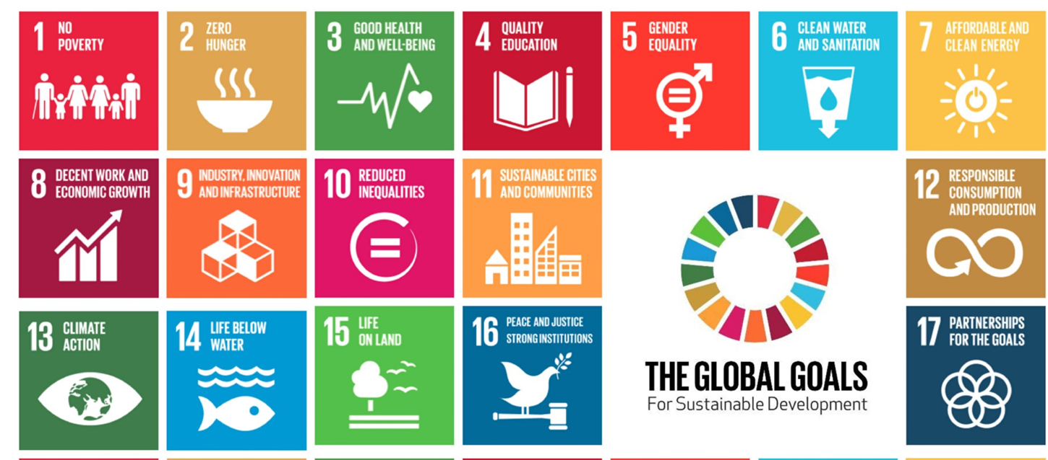
Global Context
Notes:
Strategy developed and informed by Sustainable development goals

Slide 4
UK Context
UK Aid Strategy
Strengthening global peace, security and governance
Strengthening resilience and response to crises
Promoting global prosperity
Tackling extreme poverty and helping the world’s most vulnerable
Notes:
….And the UK aid strategy

Slide 5














GCRF Delivery Partners
Notes:
Explain allocations have been given to indivdual DPs and there is also the Collective fund which is more cross-cutting and large scale

Slide 6
Strategic Advisory Group Membership
Prof Sir Mike Aaronson University of Surrey (Chair)
Prof Katrina Brown University of Exeter
Ms Jess Camburn ELRHA
Prof Barbara Evans University of Leeds
Prof Charles Godfray University of Oxford
Prof Sir Andy Haines London School of Hygiene & Trop. Med.
Prof Richard Jones University of Sheffield
Prof Helen Sang University of Edinburgh
Prof James Stirling Imperial College London
Mr Simon Trace International Development Consultant
Prof Jeff Waage London International Development Centre
Prof Jim Watson UK Energy Research Centre
Prof Sir Alan Wilson University College London
Prof Alan Winters University of Sussex

Slide 7
Research agenda for enabling change
Equitable access to sustainable development
to create new knowledge and drive innovation that helps to ensure that everyone across the globe can prosper through access to health, food, water, education, energy etc.
Sustainable economies and societies
to identify new responses to the challenges arising from changes in population, technology, consumption and pressure on the environment
Human rights, good governance and social justice
to understand how to strengthen the institutions that underpin peaceful societies, good governance, respect for human rights and the rule of law.
Notes:
With these two strategies as a basis as well as DFID research priorities and a wider engagement process with UK academics we have come up with a framework for the development of research challenges for the fund. Falls under the following three headings:

Slide 8
Research agenda for change (1)
Equitable access to sustainable development
Our vision is to create new knowledge and drive innovation that helps to ensure that everyone across the globe has access to:
Secure and resilient food systems supported by sustainable marine resources and agriculture
Sustainable health and well being
Inclusive and equitable quality education
Clean air, water and sanitation
Affordable, reliable, sustainable energy

Slide 9
Research agenda for change (2)
Sustainable economies and societies
Our ambition is to identify new responses to the challenges arising from changes in population, technology, consumption and pressure on the environment:
Sustainable livelihoods supported by strong foundations for inclusive economic growth and innovation
Resilience and action on short-term environmental shocks and long-term environmental change
Sustainable cities and communities
Sustainable production and consumption, e.g. materials and other resources

Slide 10
Research agenda for change (3)
Human rights, good governance and social justice
Our goal is to understand how to strengthen the institutions that underpin peaceful societies, good governance, respect for human rights and the rule of law. We need new insights to help:
Understand and effectively respond to forced displacement and multiple refugee crises
Reduce conflict and promote peace, justice and humanitarian action
Reduce poverty and inequality, including gender inequalities

Slide 11
Investment criteria
Official Development Assistance (ODA) compliance
meeting OECD guidelines
Problem and Solution Focused
strengthened through involvement of partners in developing countries
Research Excellence
particularly new approaches not constrained by traditional methodologies or disciplinary silos
Impact
substantial contribution to improved social welfare, economic development, and environmental sustainability in developing countries.
Capacity Building and Partnership
forging strong and enduring partnerships between UK and the Global South and by enhancing the research and innovation capacity of both.
Agile Response to Emergencies
building research evidence to support humanitarian and policy responses to disasters, crises and emergencies.

Slide 12

RCUK and the Newton Fund

Slide 13
Newton Fund
The Newton Fund uses science and innovation partnerships to promote economic development and social welfare of partner countries. It does this through collaboration with partner countries and working with 15 UK delivery partners.
The Newton Fund is also part of the UK's official development assistance (ODA).
The Newton Fund was launched in 2014 and now has a total UK investment of £735 million to 2021, with partner countries providing matched resources within the fund.

Slide 14
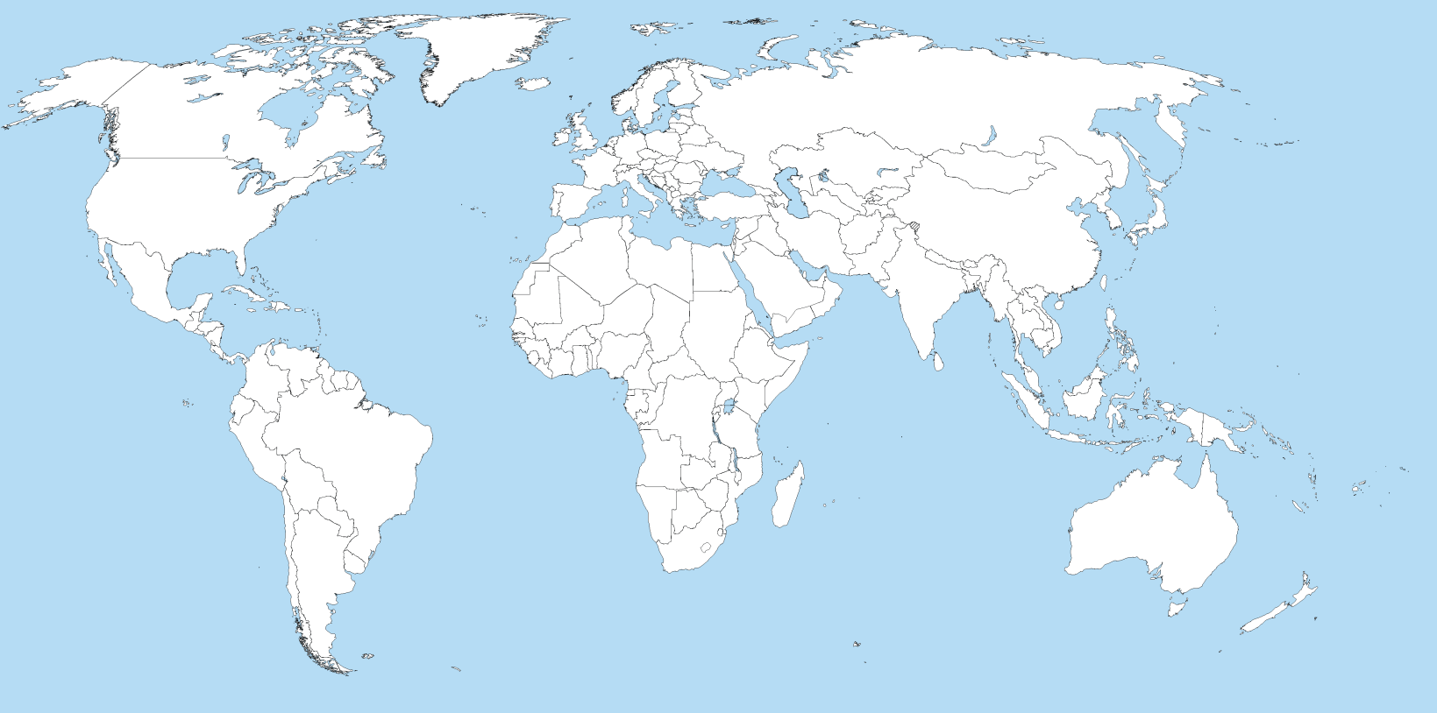
Partner countries
Egypt
Turkey
Kazakhstan
Mexico
China
Colombia
Philippines
Vietnam
Brazil
Thailand
Chile
Malaysia
Indonesia
South Africa
Kenya
India
Notes:
Newton is different to GCRF in that it works directly with partner countries to build research calls

Slide 15









The UK Delivery Partners
The aim is to build strong, sustainable and systemic links between UK and partner country science and innovation bases

Slide 16

RCUK and the Newton Fund
Our overall objective for our Newton Fund activities is Equitable Partnerships by which we mean:
Delivery funder to funder
Researcher to researcher
Matching our strengths with the strengths of our partner(s)
Addressing the development needs of our partner country.
The Research Councils collectively are the largest delivery partner for the Newton Fund; together we are responsible for delivering around £200m of the original Fund.

Slide 17
Our RCUK approach
focus of activities in the research pillar
also have activities in both the people and translation pillars
working closely with many other delivery partners within the UK and overseas.
some calls run by individual councils, and others are cross-council.
over half of our activities involve more than one Council.
strategic approach including cross-cutting themes.
Notes:
There are three pillars, research, people and translation

Slide 18
RCUK activities through the
Newton Fund: examples
  Research
    Scoping
    Full scale research programmes
    Networks
    Joint centres
  People: Capacity building and skills development e.g. International PhD Partnering, staff exchanges with other research funding agencies, STEM
Translation: Research & Innovation Bridges (Innovate UK lead)
Notes:
Scoping: shorter term funding for exploratory research – understanding and preparing the landscape to focus for future research at scale
Full scale research programmes: Longer term larger scale addressing key development challenges
Networks: Linking institutions in partner countries to increase their competitiveness for future opportunity
Joint centres: More major research programmes linking research organisations

Slide 19
Current GCRF opportunities
EPSRC Diagnostics, prosthetics and orthotics to tackle health challenges in developing countries (15th May)
MRC/AHRC GCRF Global Public Health; Partnership Awards pre-call announcement (8th June)
AHRC Research Networking Highlight Notice for International Development (25th April)
More details on www.rcuk.ac.uk/gcrf

Slide 20
Current Newton opportunities
Innovate UK: Urban innovation in Brazil (3 May)
MRC - UK-Philippines: Joint Health Research Initiative Call for concept proposals (11 May)
British Council: Information and Communications Technologies in Homes and Cities for the Health and Well-Being of Older People (20th May)
These and other forthcoming calls listed on Newton website: http://www.newtonfund.ac.uk/funding/funding-opportunities/

Slide 21
Contact
Eloise Meller
gcrf@rcuk.ac.uk
www.rcuk.ac.uk/gcrf

